Slide 1
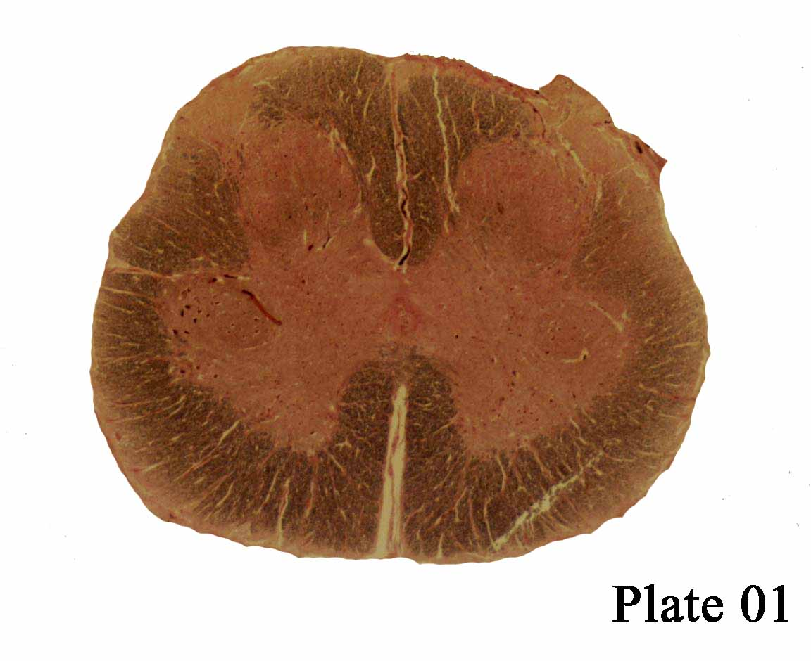
PSA
Fasciculus Gracilis
Sacral
PSA
Lateral corticospinal tract
Lateral motor nucleus
Medullary Reticulospinal
tract
Anterolateral System
Medial motor nucleus
Propriospinal tract
Pontine
reticulospinal
tract
ASA
Notes:
Plate One= Sacral
Fasciculus Gracilis= I/L 2PV to LE
Lateral corticospinal tract= I/L motor
Lateral motor nucleus= I/L Appendicular muscles
Medial motor nucleus= I/L Axial muscles
Medullary Reticulospinal Tract= I/L Facilitates flexors
ALS= C/L protopathic
Propriospinal tract= burning pain, itch and warming
Pontine reticulospinal tract= I/L facilitates exentsion
*Anterior white commisure= only pain/temp AT THAT LE EL

Slide 2
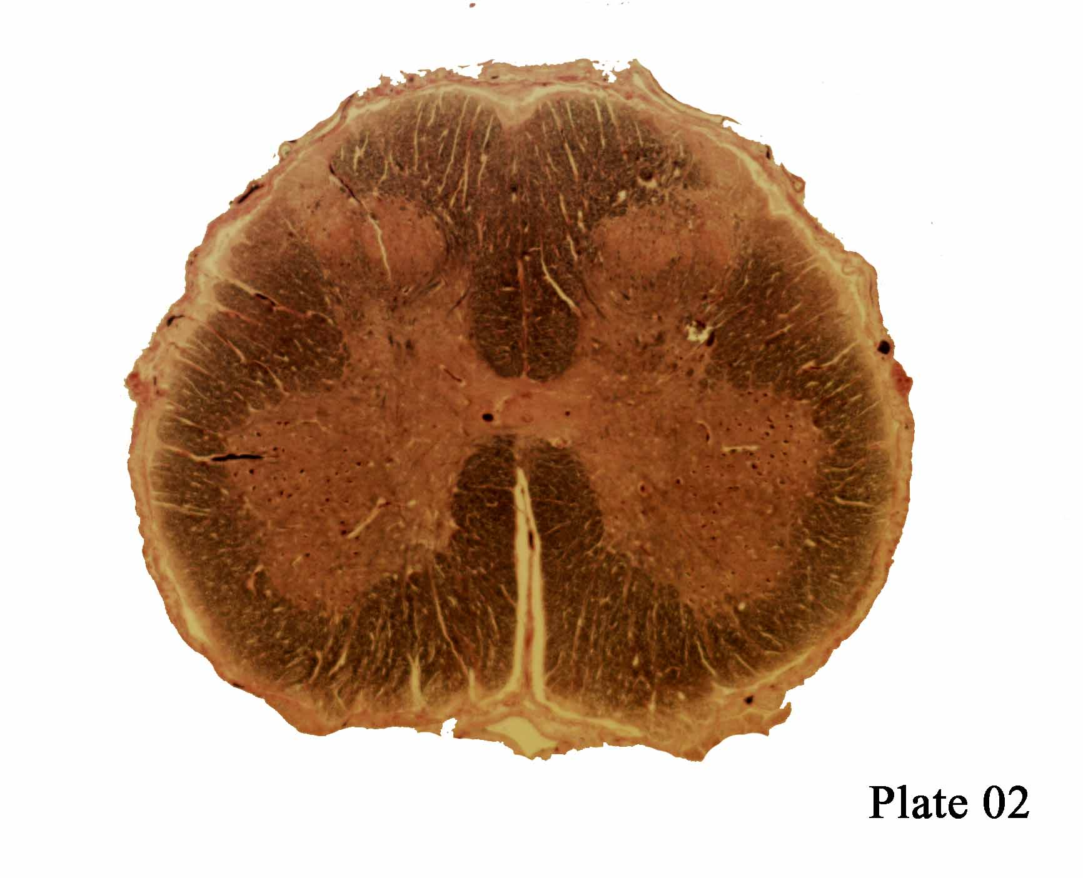
Facilis Gracilis
PSA
PSA
Dorsalateral Funiculus
Lumbar
Lateral corticospinal tract
Lateral motor nucleus
Medullary Reticulospinal
tract
Anterolateral System
Medial motor nucleus
Pontine reticulospinal tract
Anterior Corticospinal Tract
Lateral Vestibulospinal tract
ASA
Notes:
NEW
Dorsalateral Funiculus- I/L Protopathic sensation
Lateral Vestibulospinal Tract- I/L facilitate extensors
Anterior corticospinal tract- I/L axial musculatrue

Slide 3
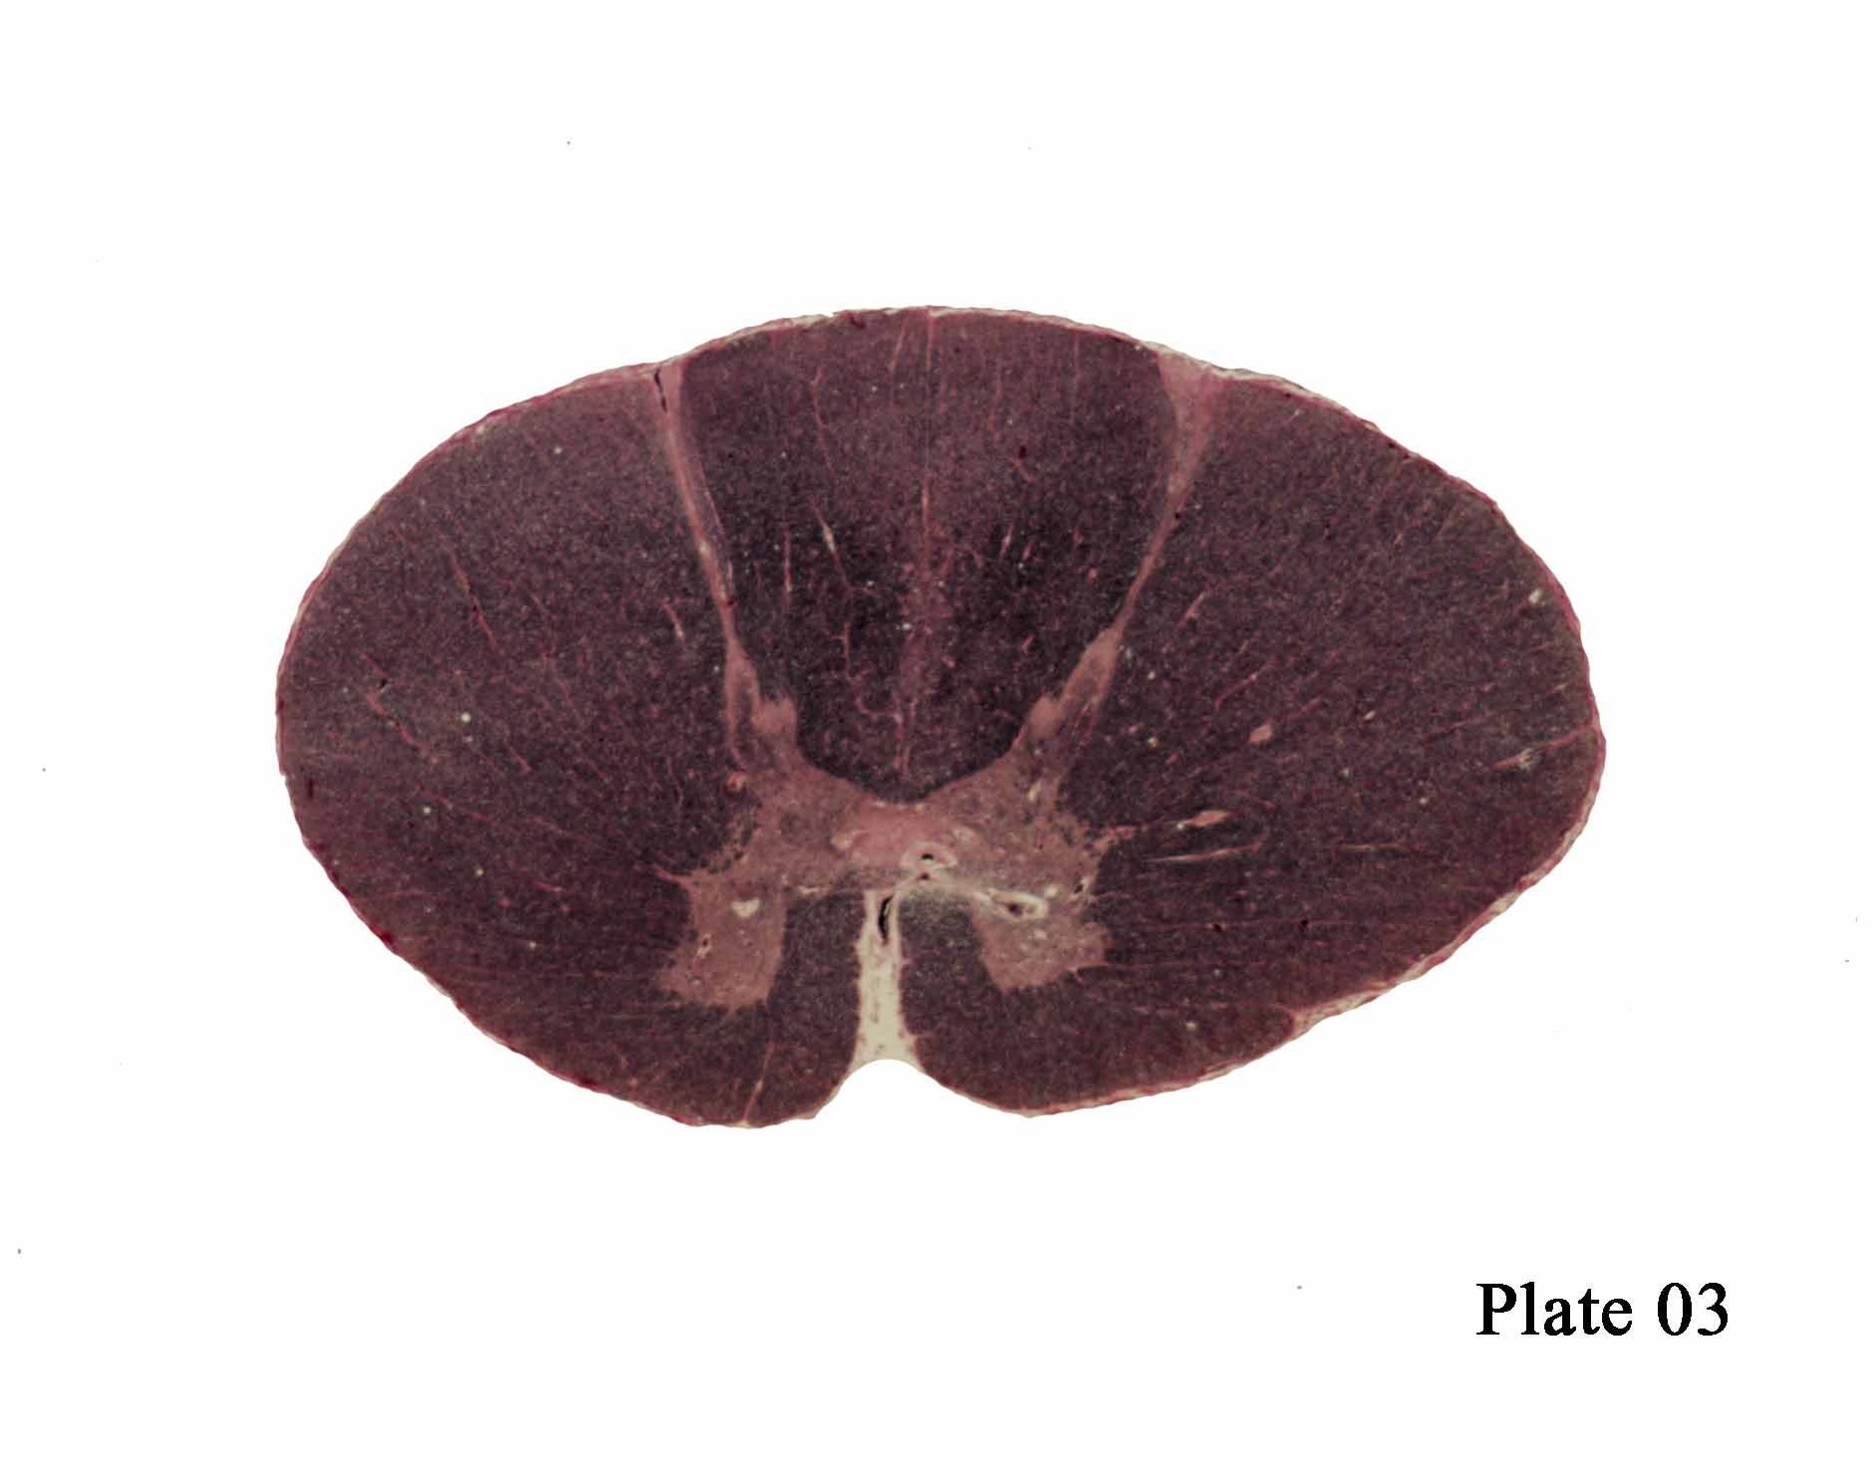
Fasciculs Cuneatus
Dorsolateral Funiculus
Fasciculus Gracilis
Thoracic
Lateral corticospinal tract
Dorsal Spinocerebellar Tract
Rubrospinal Tract
Ventral Spinocerebellar Tract
Medullary Reticulospinal tract
Nucleus Clarke
Anterolateral System
Pontine reticulospinal tract
Anterior Corticospinal Tract
Lateral Vestibulospinal tract
Notes:
NEW
Fasciculus Cuneatus- I/L 2PV UE
Dorsal Spinocerebellar Tract- a-alpha fibers from muscle spindle fibes & golgi tendon organs. Propioception- I/L.
Rubrospinal Tract- I/L flexors of UE
Ventral Spinocerebellar Tract- Propioception I/L
Nucleus of Clark- C8-L3= DSCT I/L ataxia

Slide 4
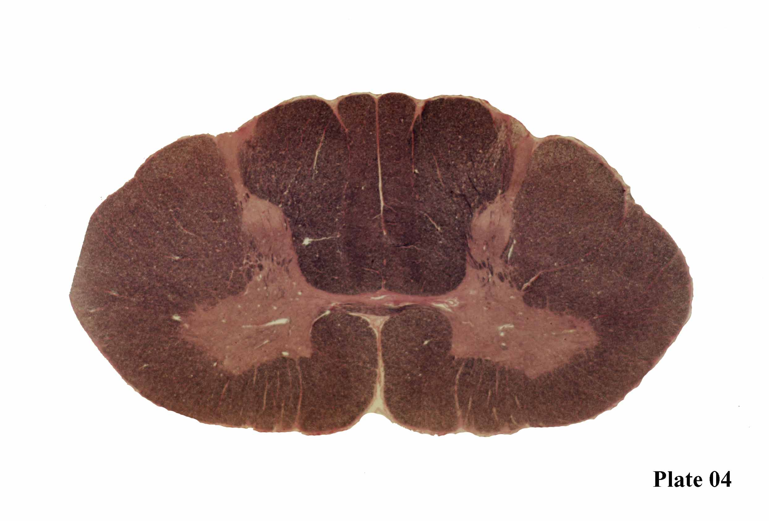
Cervical
Fasciculs Cuneatus
Fasciculus Gracilis
Dorsolateral Funiculus
Lateral corticospinal tract
Dorsal Spinocerebellar Tract
Rubrospinal Tract
Medial Longitudnal Fasciculus
Ventral Spinocerebellar Tract
Medullary Reticulospinal tract
Anterolateral system
Anterior Corticospinal Tract
Lateral Vestibulospinal tract
Pontine reticulospinal tract
Notes:
NEW
Medial Longitudinal Fasiculus= CN VI control over CN III. Internuclear Opthalmopalegia (ipsilateral MR on lateral gaze)

Slide 5
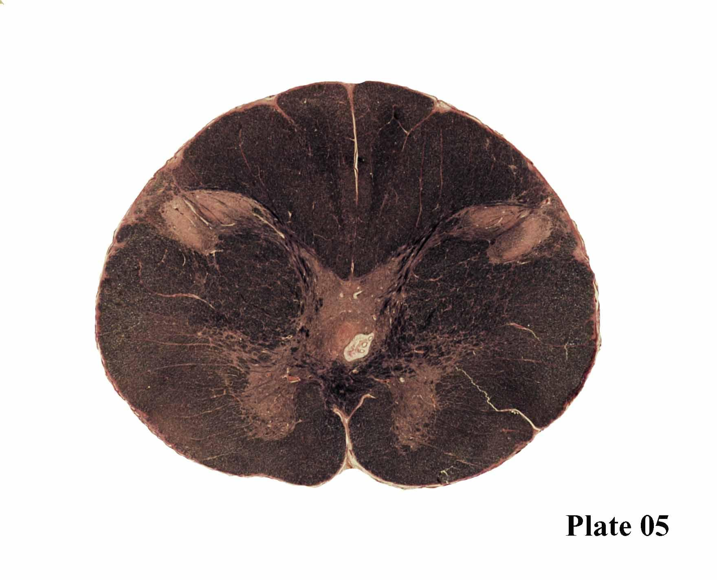
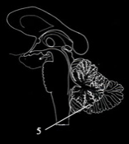
Spinal Trigeminal Nucleus
Fasciculs Cuneatus
Fasciculus Gracilis
Spinal Trigeminal Tract
Lateral corticospinal tract
Dorsal Spinocerebellar Tract
Rubrospinal Tract
Accessory Nucleus CN11
Ventral Spinocerebellar Tract
Medial Longitudnal Fasciculus
Medullary Reticulospinal tract
Anterolateral System
Lateral Vestibulospinal tract
Pontine reticulospinal tract
Techtospinal tract
Anterior Corticospinal Tract
Notes:
New
Spinal Trigeminal Tract/N: Protopathic face (I/L)
Techtospinal tract: Mediates neck reflexes, especially related to visual and acoustic stimuli
Accessory Nucleus CN11= SCM and trapezius

Slide 6
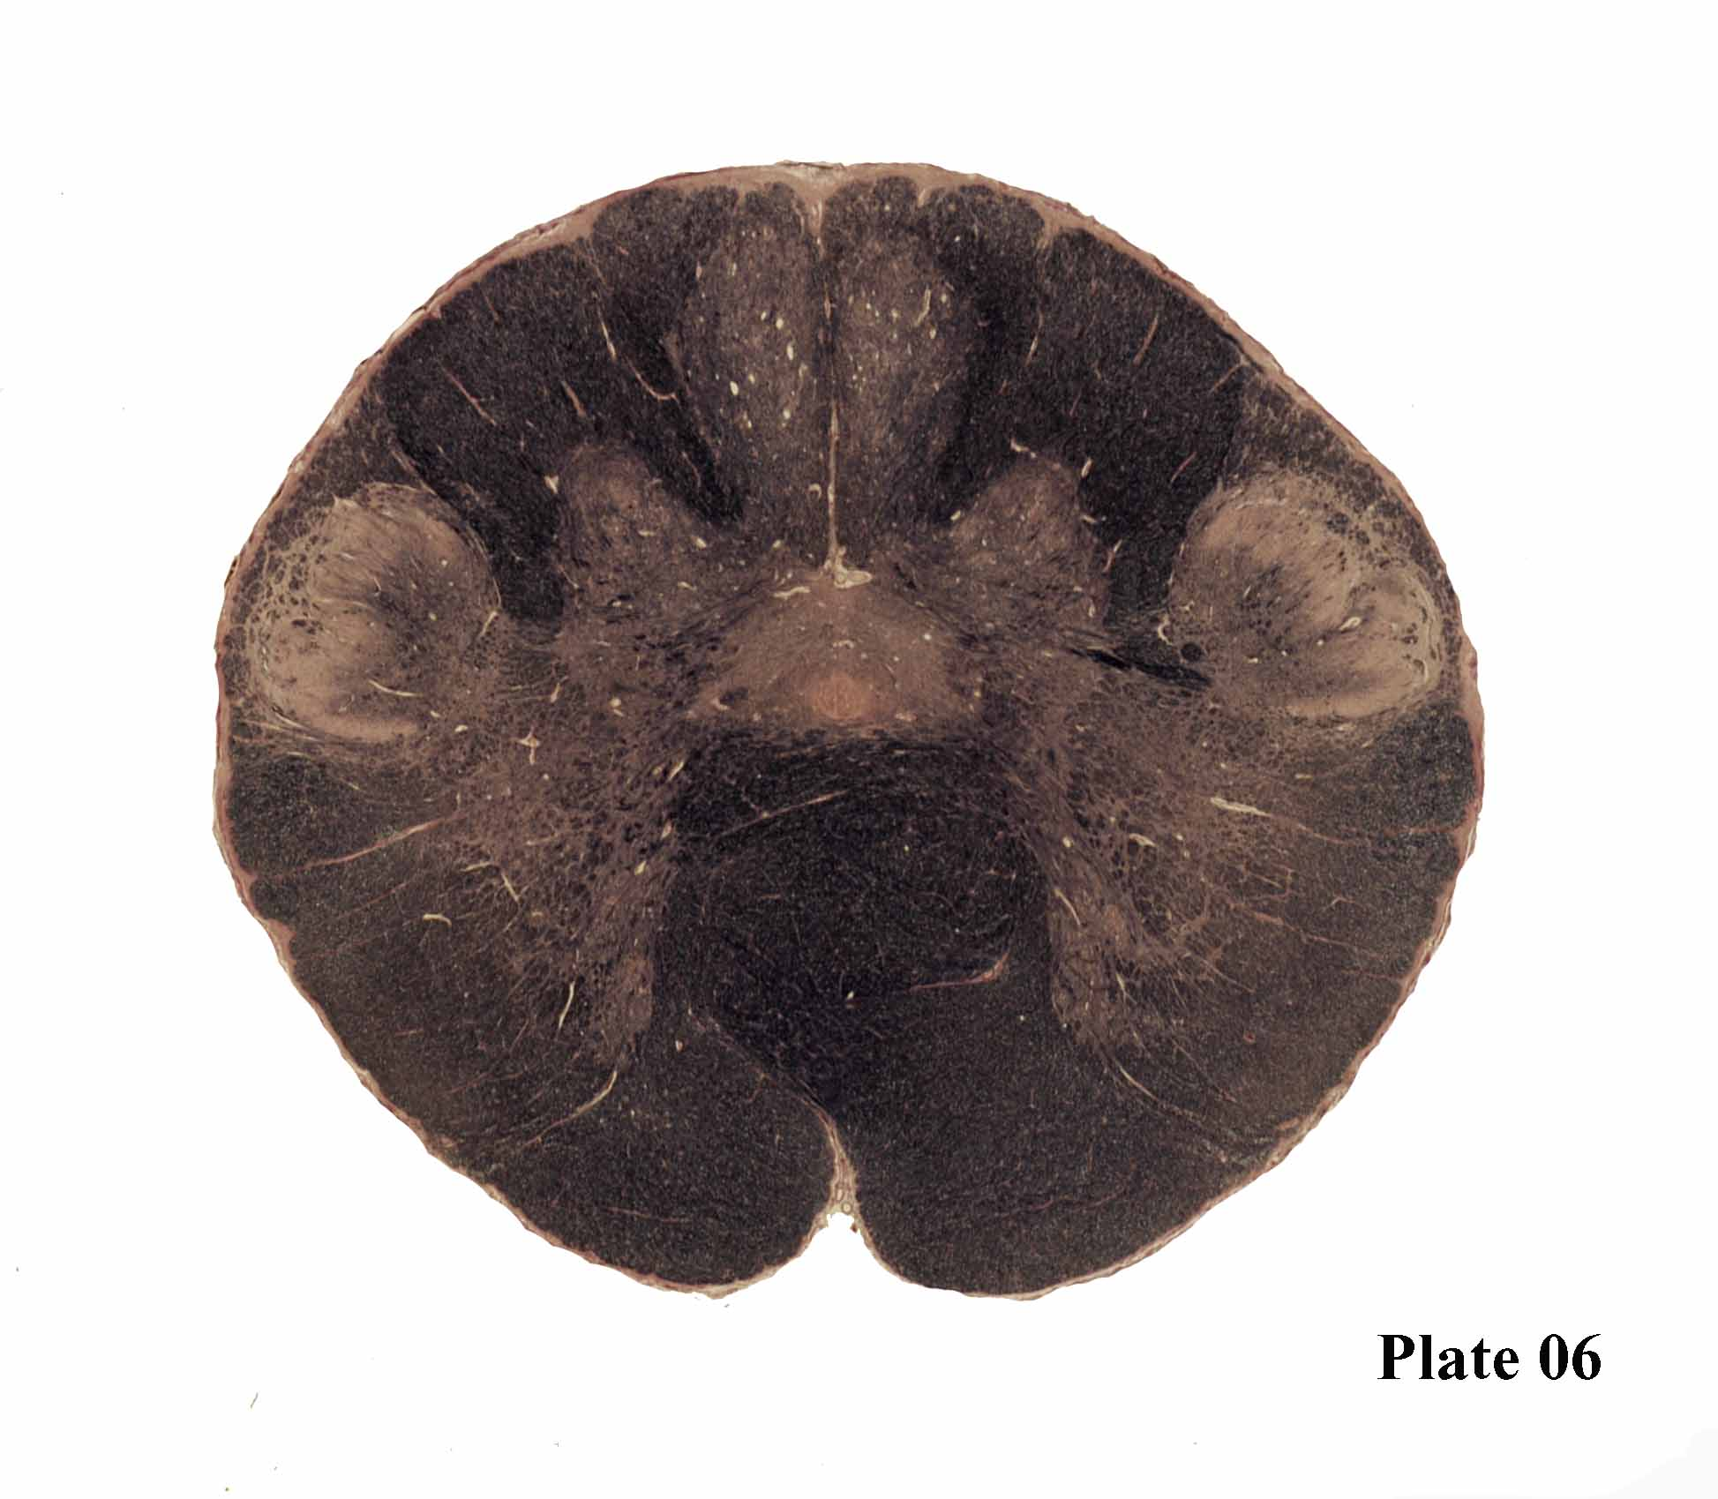
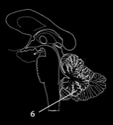
Fasciculus Gracilis tract
Fasciculs Cuneatus tract
Nucleus
gracilis
Spinal Trigeminal Tract
Nucleus
cuneatus
Spinal Trigeminal Nucleus
Medullary Reticular formation
Central Grey
Dorsal Spinocerebellar Tract
Accessory Nucleus
Rubrospinal Tract
Medial Longitudnal Fasciculus
Ventral Spinocerebellar Tract
Techtospinal tract
Anterolateral system
Pyramidal Tract- decussation
Pyramidal Tract
Pontine reticulospinal tract & Lateral Vestibulospinal tract
Notes:
New:
Nucleus gracilis- legs
Nucleus cuneatus- arms
Central grey- Central Gray- hypoglossal and vagal nuclei will be contained within this region in plates 7-9
Pyramidal Tract- Decussation

Slide 7
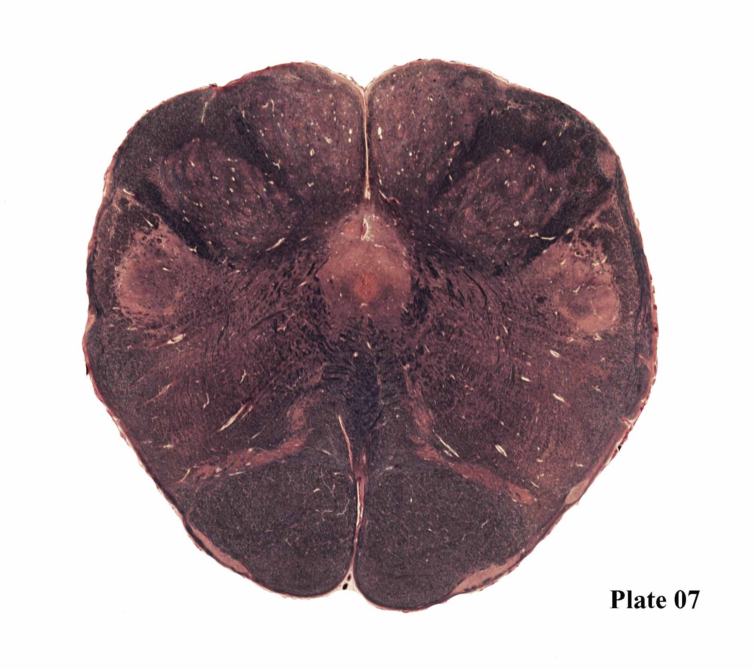
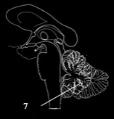
Fasciculs Cuneatus tract
Fasciculus Gracilis tract
Gracilis Nucleus
Dorsal Spinocerebellar Tract
Cuneatus Nucleus
Spinal Trigeminal Tract
Solitary Nucleus
Spinal Trigeminal Nucleus
Dorsal Motor Nucleus
Ventral Spinocerebellar Tract
Internal Arcuate fibers
Hypoglossal Nucleus
Medial Longitudnal Fasciculus
Rubrospinal Tract
Techtospinal tract
Nucleus Ambiguous
Anterolateral system
Pontine reticulospinal tract & Lateral Vestibulospinal tract
Decussation Medial Lemniscus
Pyramidal Tract
Medial Accessory Olivary Nucleus
Notes:
New
Medial Accessory Olivary Nucleus-
Pyramidal Tract- MOTOR
Decussation of Medial Lemniscus- 2PV of body (happens in caudal medulla)
Nucleus Ambiguous- CN IX and X= Dysphagia, dyspnea and dysarthria
TMHDS (Plate 7)
Too Much Head Does Suck
Techtospinal/ Medial Longitudinal/ Hypoglossal/ Dorsal Motor/ Solitary

Slide 8
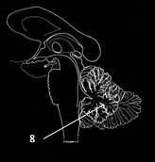
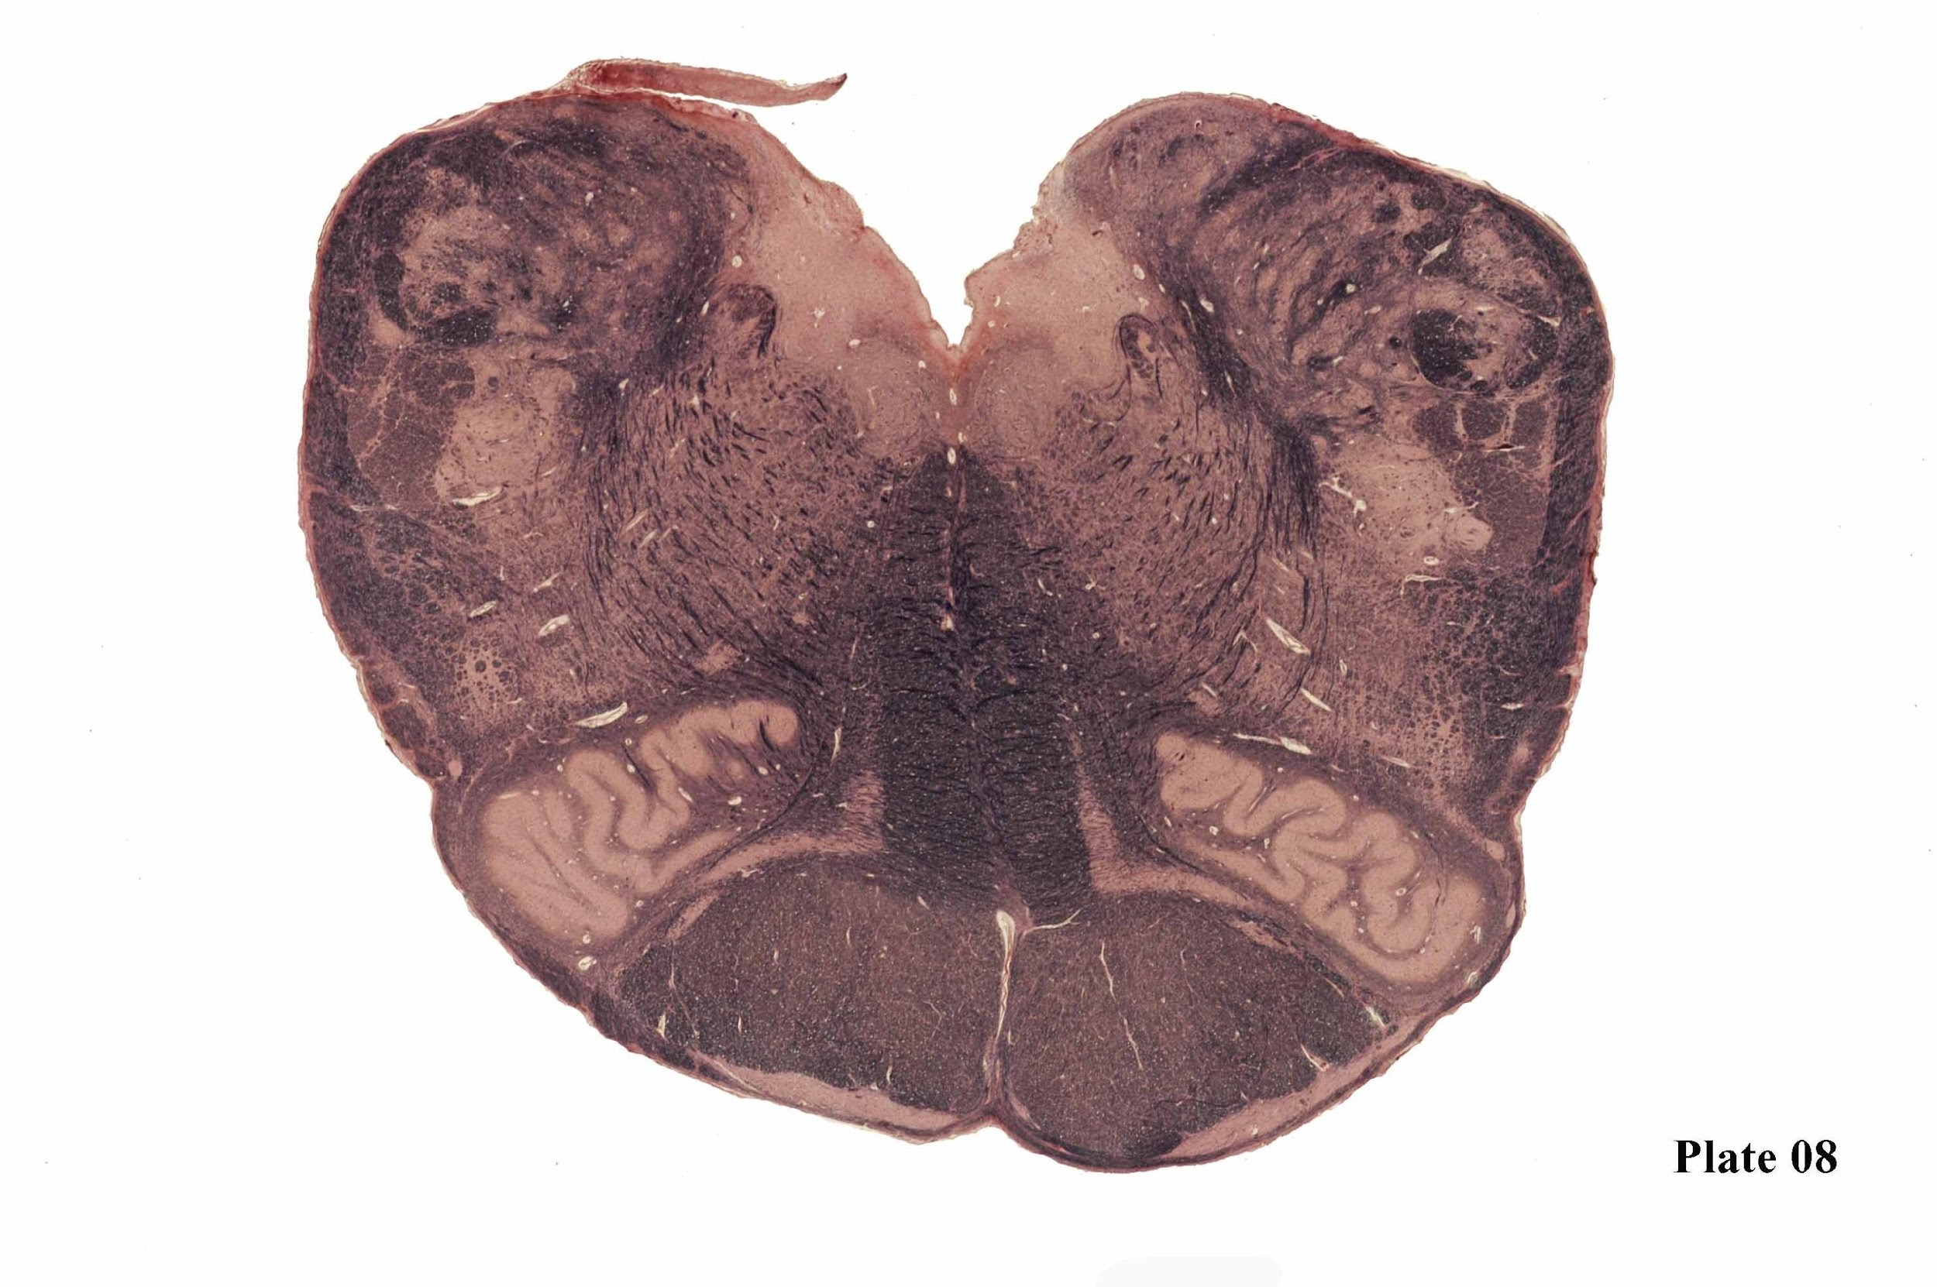
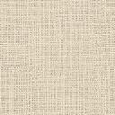
Fasiculus cuneatus
Inferior Cerebellar Peduncle
Cuneatus Nucleus
Solitary Nucleus
Lateral Cuneatus Nucleau
Solitary Nucleus Tract
DorsalMotor Nucleus
Dorsal Longitudnal Fasciculus
Spinal Trigeminal Tract & Nucleus
Hypoglossal Nucleus
Ventral Spinocerebellar Tract
Medullary reticular formation
Nucleus Ambiguous
Medial Longitudnal Fasciculus
Internal Arcuate fibers
Techtospinal tract
Rubrospinal Tract
Anterolateral system
Medial Lemniscus
Pontine reticulospinal tract & Lateral Vestibulospinal tract
Central Tegmental Tract
Principal Inferior Olivary Nucleus
Pyramidal Tract
Medial Accessory Inferior Olivary Nucleus
Notes:
New
Inferior Cerebellar Peduncle- I/L propioception (unconcious ataxia if damaged)
Solitary Nucleus Tract- Dyspnea, pseudoasthma, vomiting and possibly coughing due to interruption of the vagal reflex, arcs are signs of damage in the vicinity of the solitary nucleus or its connections. Diminution or loss of the gag reflex can result from lesions of the vagal afferent fibers or the solitary nucleus or tract. Loss of taste can result from damage to the gustatory component of the solitary nucleus.
Central Tegmental Tract- connects rostral brain stem with the medulla. Damage: palatal myoclonus, which presents as rhythmic contractions of the palate.
Principal Inferior Olivary Nucleus- involved in motor learning
Dorsal Longitudinal Fasiculus- influence the brain stem nuclei involved in regulating the autonomic nervous system.
Medullary Reticular Formation- regulating cardiovascular and pulmonary functions as well as other autonomic nervous system processes
Damage: Lesions of the reticular formation can present with dysautonomia, such as tachycardia and non-rhythmic respiration rates. Lesions of the descending autonomic
fibers can present as Horner’s syndrome—ptosis, miosis, and anhidrosis—on the ipsilateral face.
Medial Lemniscus- contains the output from the dorsal column nuclei and nucleus Z. Thus,damaging this tract is similar to combined lesions of the dorsal columns of the spinal cord and the cuneo- and dorsal spinocerebellar tracts. The patient experiences loss of two-point discrimination, position, and vibratory sense.

Slide 9
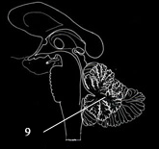
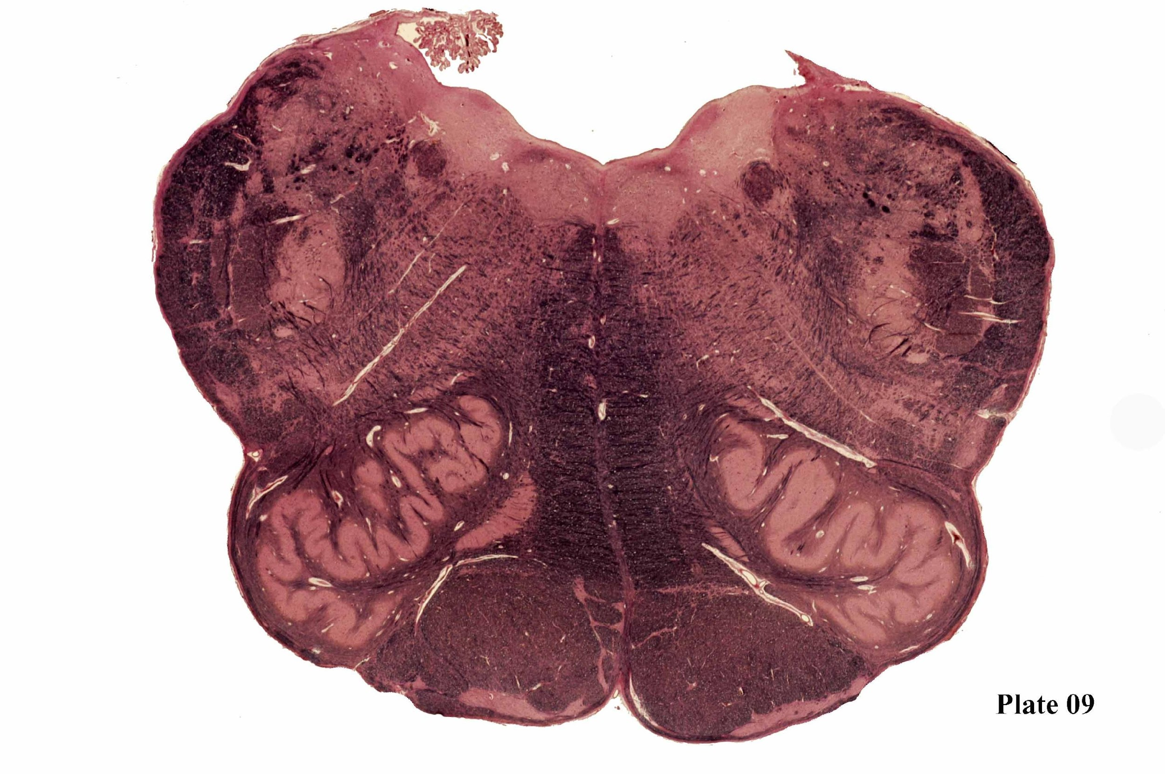
Spinal Vestibular Nucleus
Medial Vestibular Nucleus
Solitary Nucleus
Inferior Cerebellar Peduncle
Dorsal Motor Nucleus
Lateral Cuneatus Nucleau
Solitary Nucleus Tract
Dorsal Longitudnal Fasciculus
Hypoglossal Nucleus
Spinal Trigeminal Tract & Nucleus
Ventral Spinocerebellar Tract
Medullary reticular formation
Medial Longitudnal Fasciculus
Nucleus Ambiguous
Techtospinal tract
Rubrospinal Tract
Lateral Reticular Nucleus
Pontine reticulospinal tract & Lateral Vestibulospinal tract
Medial Lemniscus
Anterolateral system
Central Tegmental Tract
Principal Inferior Olivary Nucleus
Pyramidal Tract
Medial Accessory Inferior Olivary Nucleus
Notes:
Lateral Reticular Nucleus-
Medial Vestibular Nucleus
Spinal Vestibular Nucleus

Slide 10
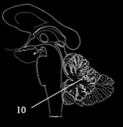
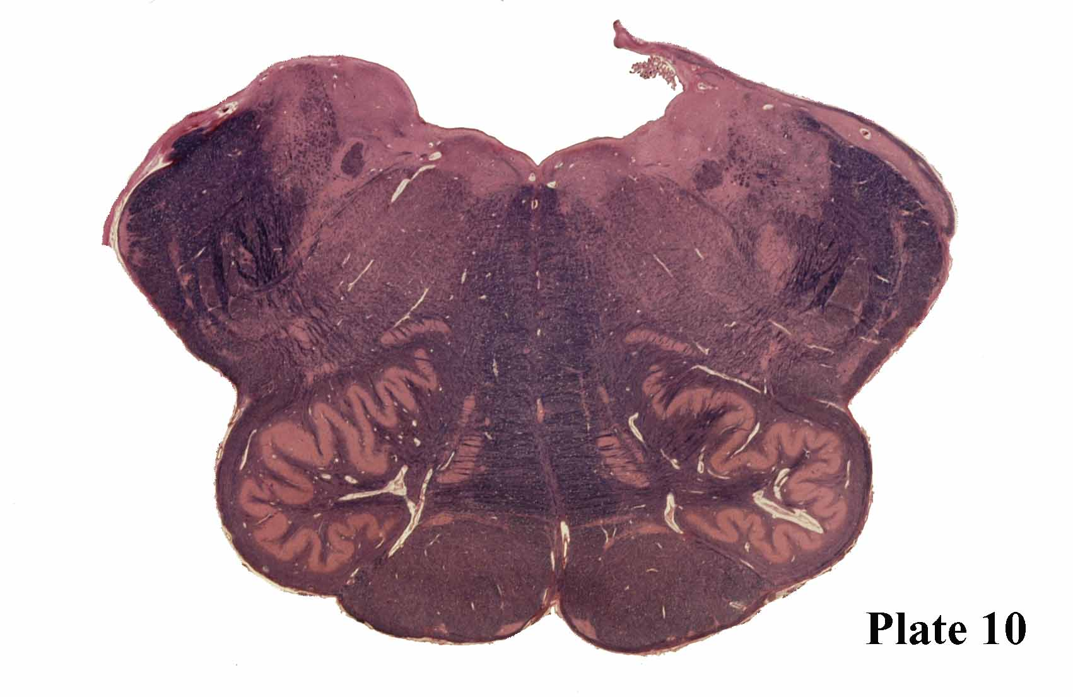
Medial Vestibular Nucleus
Spinal Vestibular Nucleus
Inferior Cerebellar Peduncle
Solitary Nucleus
Dorsal Motor Nucleus
Solitary Nucleus Tract
Prepositus Hypoglossal Nucleus
Dorsal Longitudnal Fasciculus
Spinal Trigeminal Tract
Spinal Trigeminal Nucleus
Medial Longitudnal Fasciculus
Ventral Spinocerebellar Tract
Medullary reticular formation
Nucleus Ambiguous
Techtospinal tract
Rubrospinal Tract
Dorsal Inferior Accessory Olivary Nucleus
Lateral Reticular Nucleus
Pontine reticulospinal tract & Lateral Vestibulospinal tract
Medial Lemniscus
Anterolateral system
Medial Accessory Inferior Olivary Nucleus
Central Tegmental Tract
Pyramidal Tract
Principal Inferior Olivary Nucleus

Slide 11
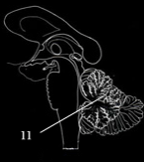
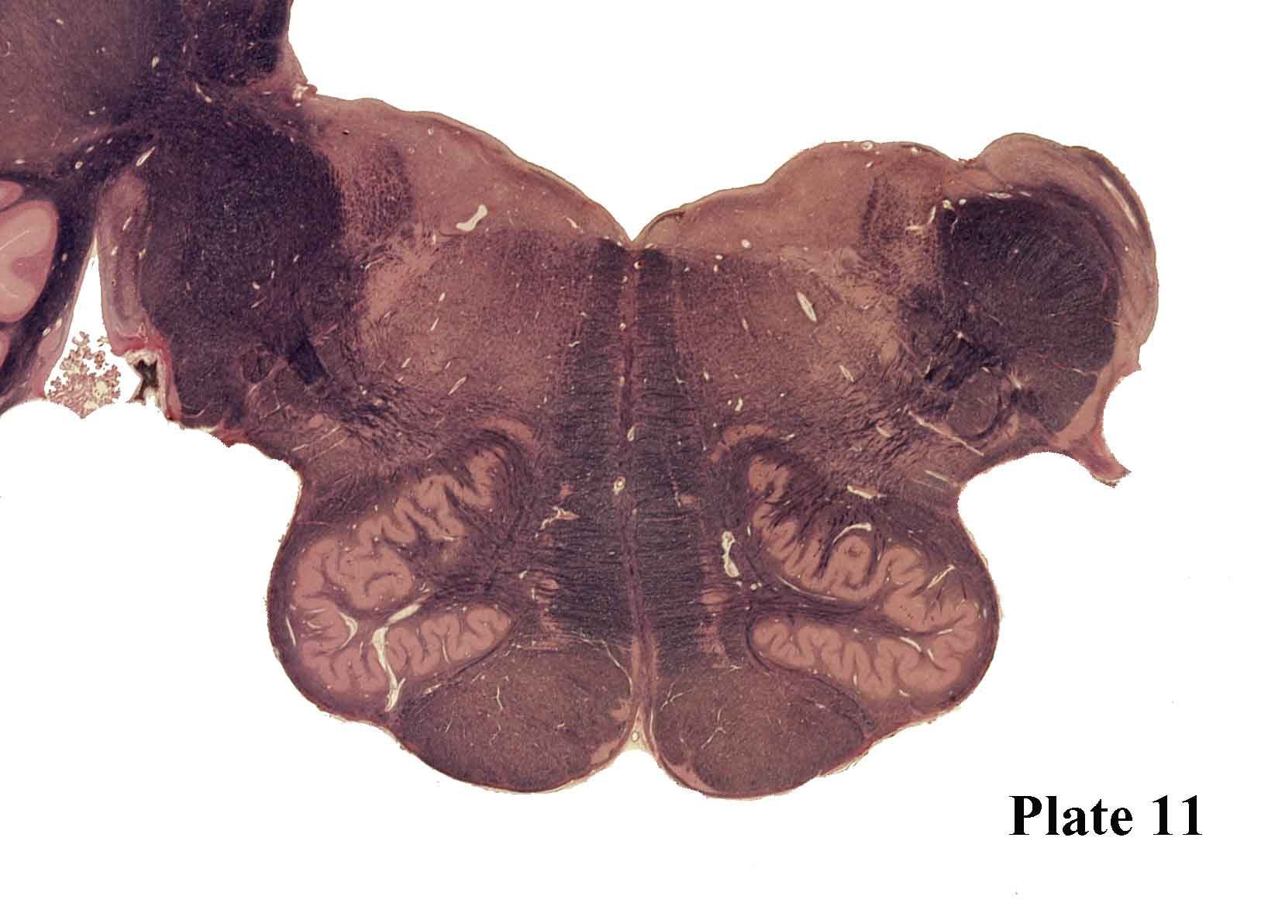
Superior Vestibular Nucleus
Spinal Vestibular Nucleus
Medial Vestibular Nucleus
Solitary Nucleus
Inferior Cerebellar Peduncle
Dorsal Longitudnal Fasciculus
Solitary Nucleus Tract
Prepositus Hypoglossal Nucleus
Inferior Salivatory Nucleus
Cochlear Nucleus
Spinal Trigeminal Nucleus
Medial Longitudnal Fasciculus
Medullary reticular formation
Nucleus Ambiguous
Spinal Trigeminal Tract
Techtospinal tract
Dorsal Inferior Accessory Olivary Nucleus
Cranial Nerve 9
ALS
Ventral Spinocerebellar Tract
Rubrospinal Tract
Medial Lemniscus
Central Tegmental Tract
Medial Accessory Inferior Olivary Nucleus
Principal Inferior Olivary Nucleus
Pyramidal Tract

Slide 12
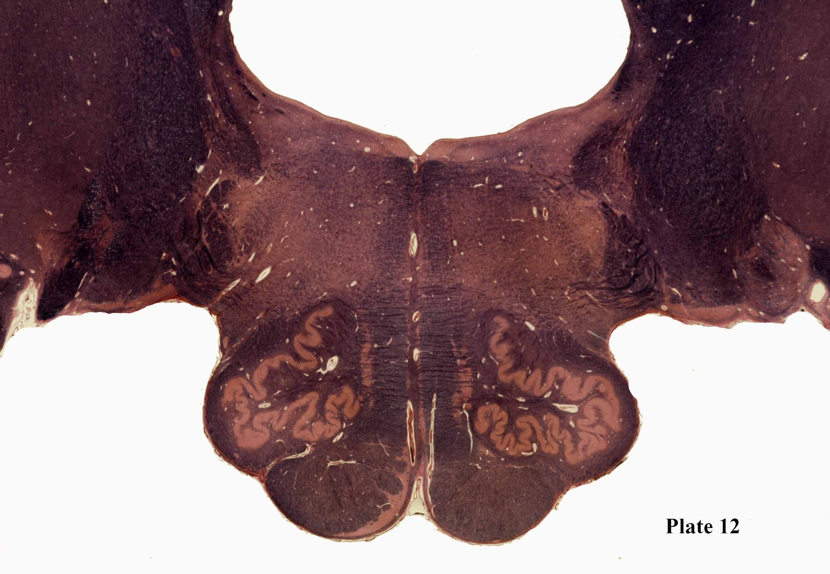
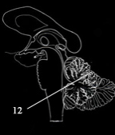
Lateral vestibular Nucleus
Superior Vestibular Nucleus
Medial Vestibular Nucleus
Dorsal Longitudnal Fasciculus
Middle Cerebellar Peduncle
Inferior Cerebellar Peduncle
Abducens Nucleus
Prepositus Hypoglossal Nucleus
Spinal Trigeminal Nucleus
Medial Longitudnal Fasciculus
Pontine Reticular Formation
Spinal Trigeminal Tract
Techtospinal tract
Facial Nucleus
Pontobulbar Nuclei
CN 8
Raphe Nucleus
ALS
Ventral Spinocerebellar Tract
Medial Lemniscus
Rubrospinal Tract
Central Tegmental Tract
Medial Accessory Inferior Olivary Nucleus
Principal Inferior Olivary Nucleus
Pyramidal Tract

Slide 13
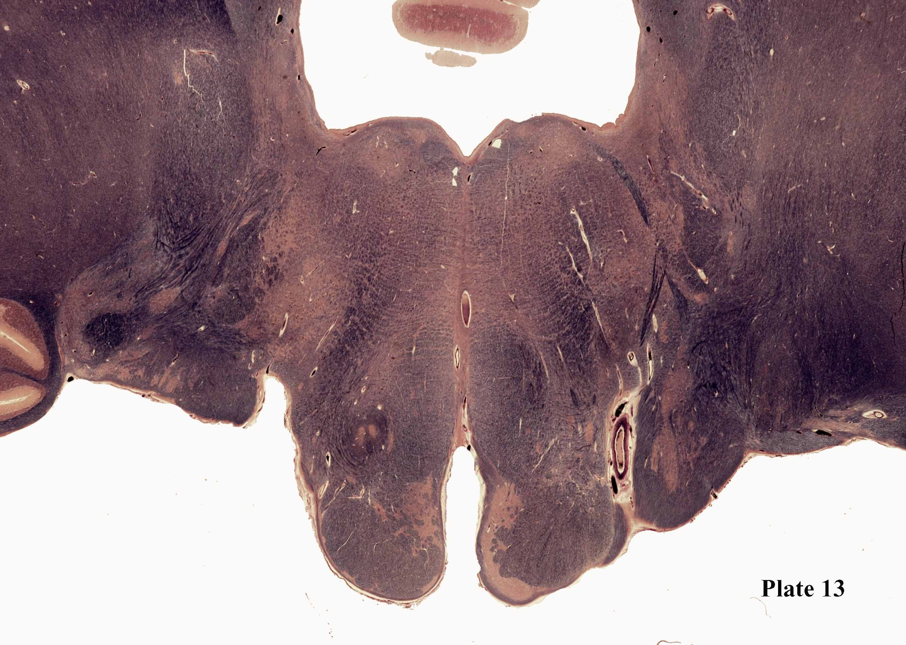
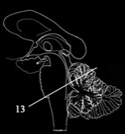
Superior Cerebellar Peduncle
Superior Vestibular Nucleus
Medial Vestibular Nucleus
Dorsal Longitudnal Fasciculus
Prepositus Hypoglossal Nucleus
Superior Salivary Nucleau
Middle Cerebellar Peduncle
Inferior Cerebellar Peduncle
Lateral vestibular Nucleus
Abducens Nucleus
Medial Longitudnal Fasciculus
Pontine Reticulo Fibers
Mesencephalic Trigeminal Nucleau
Spinal Trigeminal Nucleus
Techtospinal tract
Spinal Trigeminal Tract
Pontobulbar Nuclei
Facial Nucleus
Central Tegmental Tract
Raphe Nucleus
ALS
Facial
Nerve
Vestibulocochlear Nerve Root
Vestibulocochlear nucleus
Medial Lemniscus
Ventral Spinocerebellar Tract
Inferior Olivary Nucleus
Arcuate Nucleus
Rubrospinal Tract
Pyramidal Tract

Slide 14
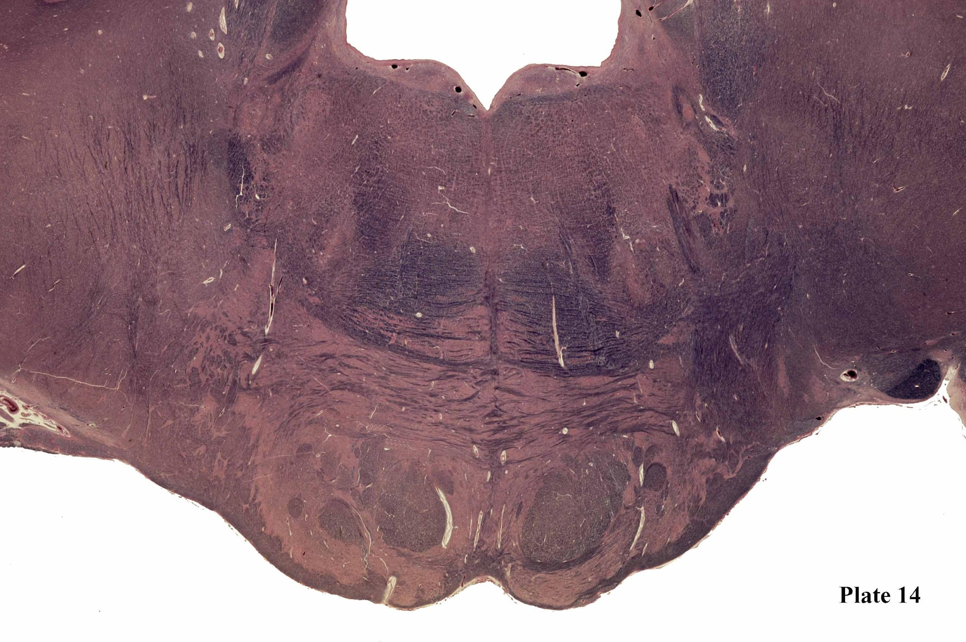
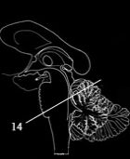
Inferior Cerebellar Peduncle
Superior Cerebellar Peduncle
Superior Vestibular Nucleus
Medial Vestibular Nucleus
Dorsal Longitudnal Fasciculus
LateralVestibular Nucleus
Mesencephalic Trigeminal Nucleau
Abducens Nucleus
Medial Longitudnal Fasciculus
Trigem Motor
Pontine Reticulo Fibers
Mesencephalic Trigeminal Nucleau
Chief Trigeminal Sensory Nucleus
Facial
Spinal Trigeminal
Techtospinal tract
Middle Cerebellar Peduncle
Superior Olive Medial Lateral
Central Tegmental Tract
Ventral Spinocerebellar Tract
Raphe Nucleus
Facial
Nucleus
Lateral Leniscus Tract and nuclei
Abducens Radiations
ALS
Medial Lemniscus
Rubrospinal Tract
Vestibulocochlear Nerve Root
Pontinocerebellar fiber
Pontine
Nuclei
Corticospinal tract

Slide 15
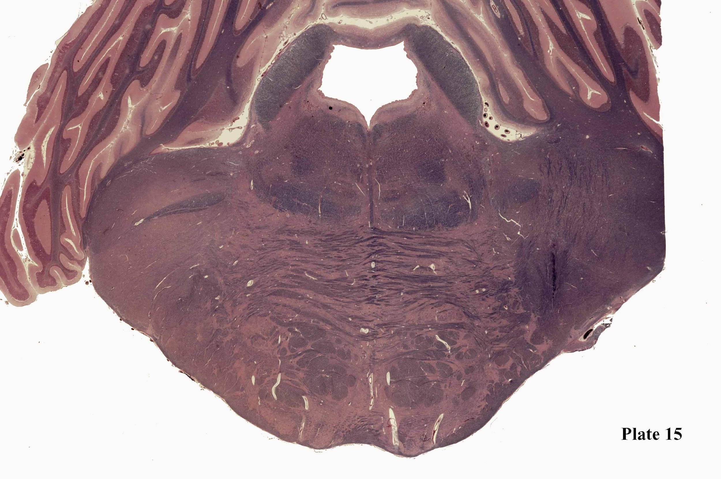
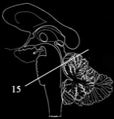
Mesencephalic Trigeminal Nucleau
Locus Corelius
Ventral Spinocerebellar Tract
Superior Cerebellar Peduncle
Dorsal Longitudnal Fasciculus
Spinal Trigeminal
Central Grey
Chief Trigeminal Sensory Nucleus
Pontine Reticulo Fibers
Medial Longitudnal Fasciculus
Central Tegmental Tract
Trigem Motor
Ventral trigeminothalamic tract
Trigeminal Radiations
ALS
Medial Lemniscus
Lateral Leniscus Tract and nuclei
Rubrospinal Tract
Middle Cerebellar Peduncle
Pontinocerebellar fiber
Pontine
Nuclei
Corticospinal tract

Slide 16
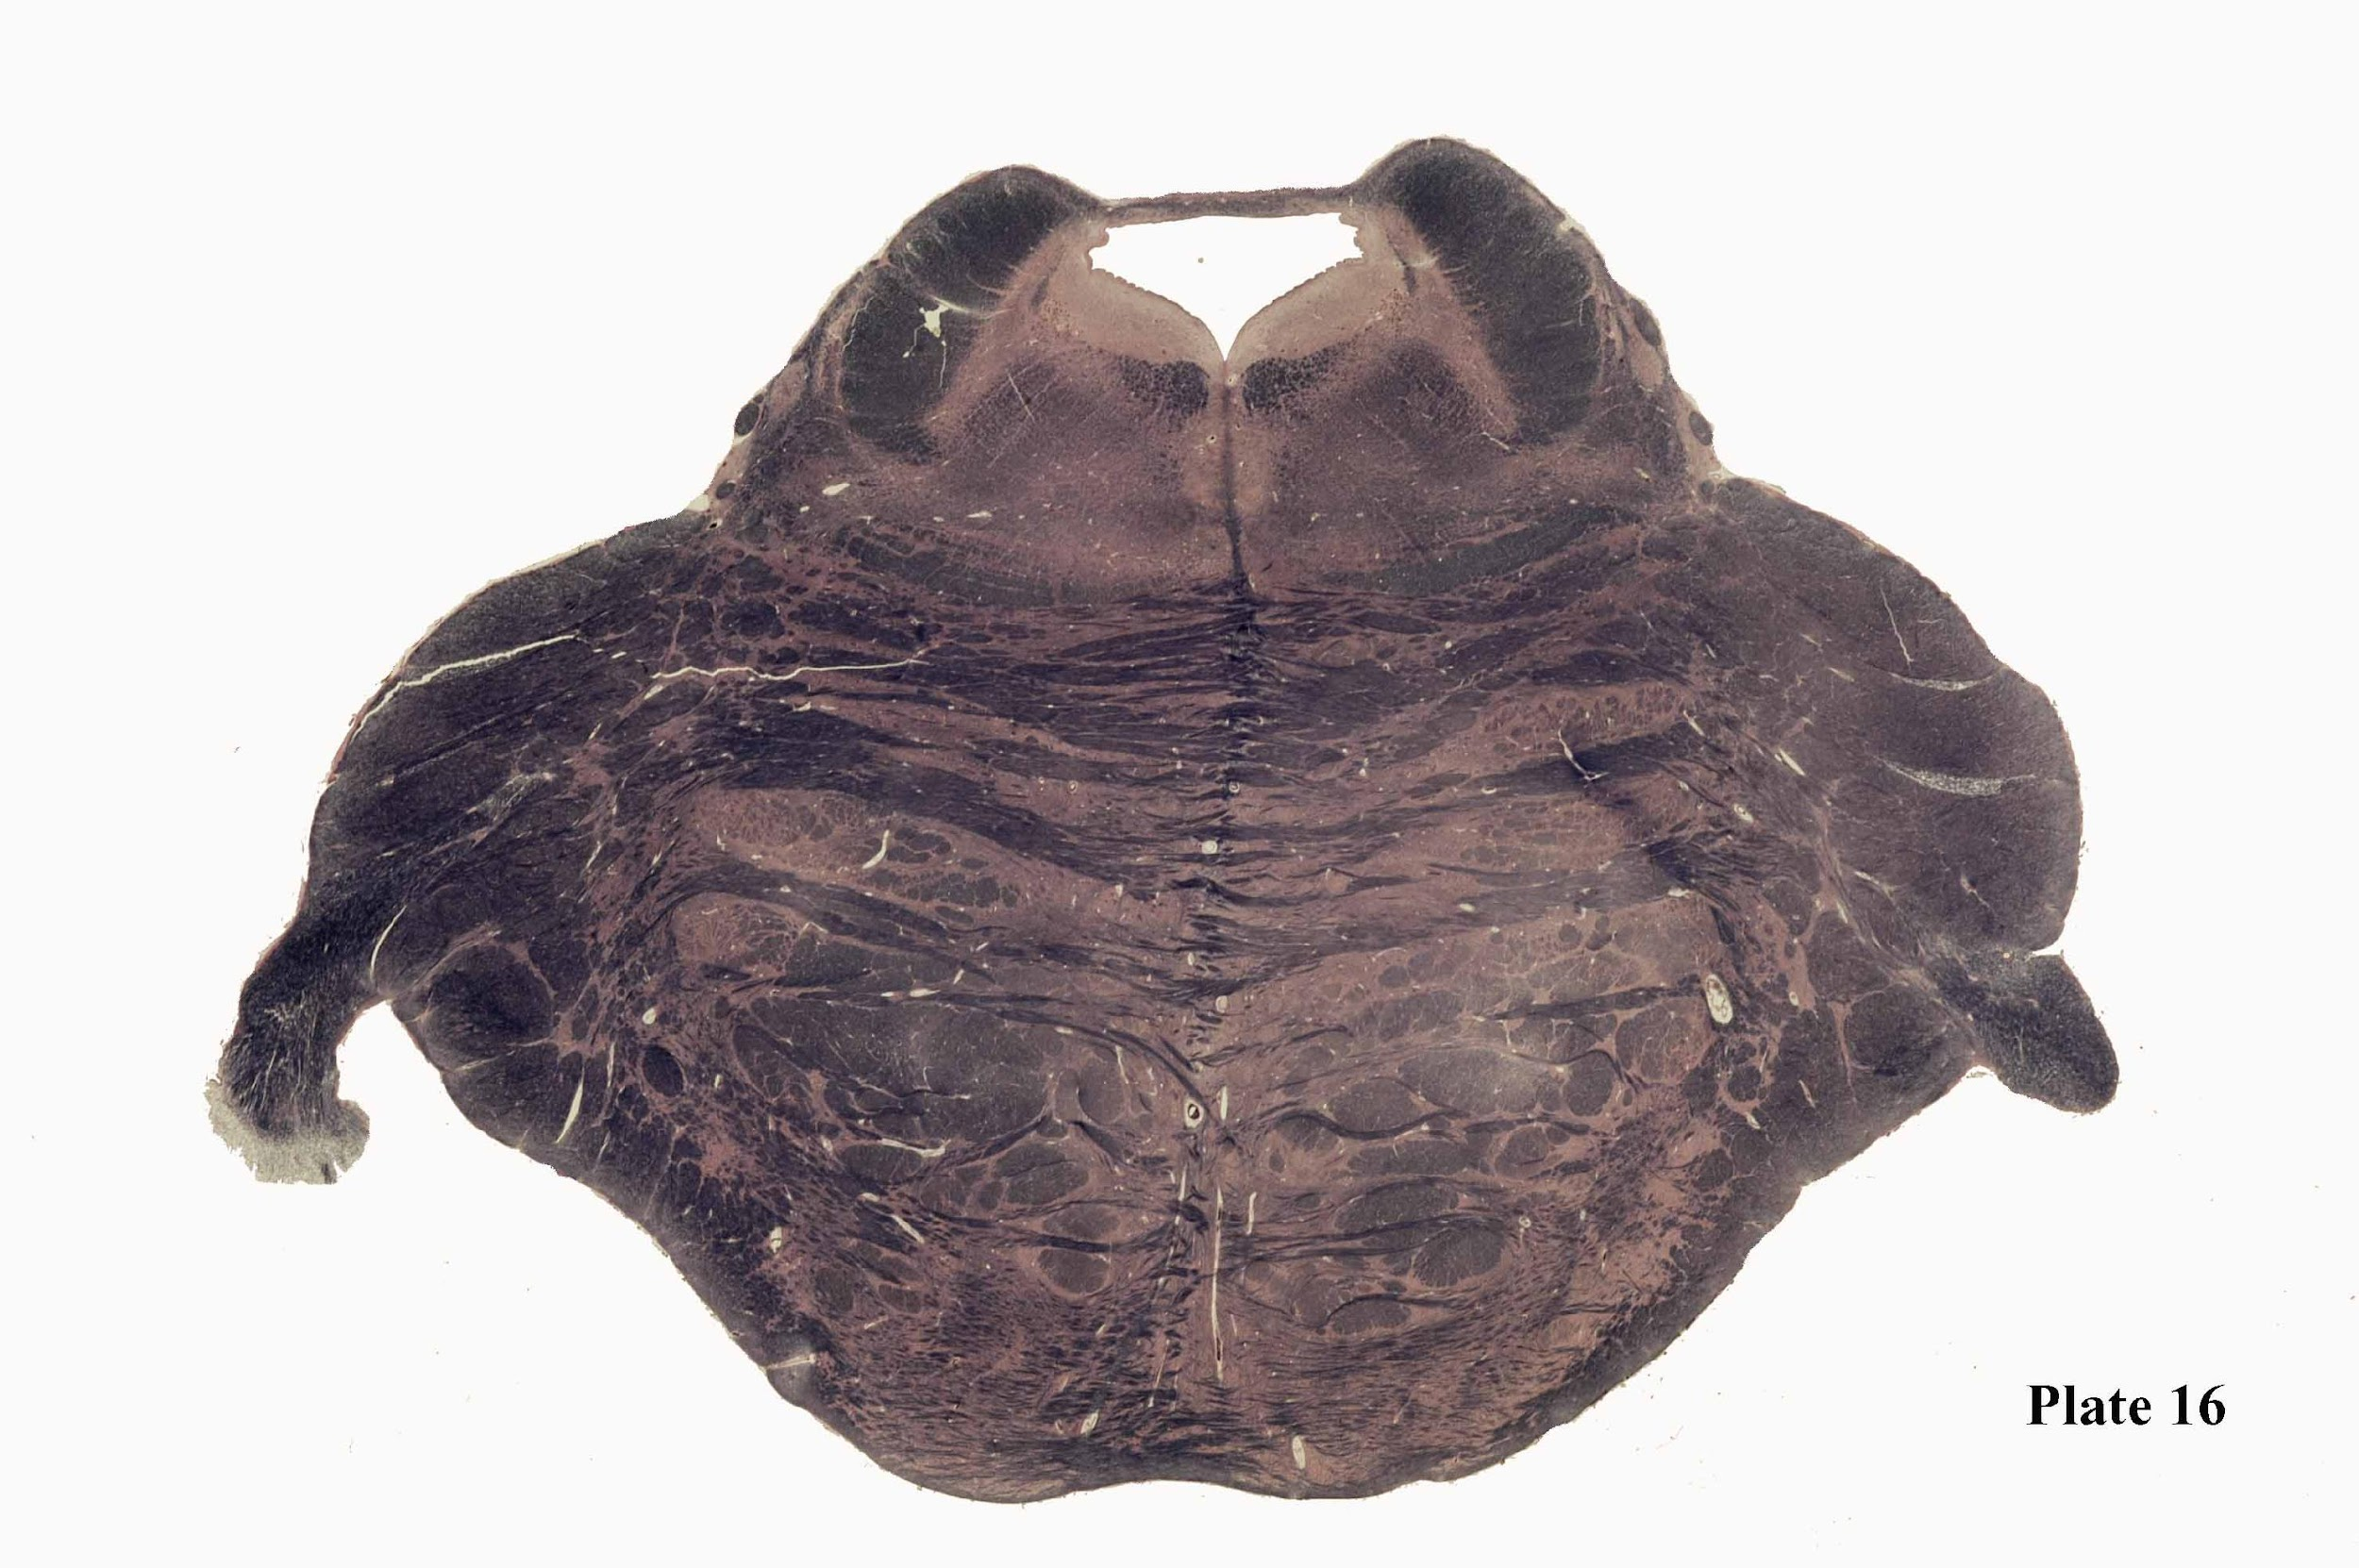
Locus Coeruleus
PRetF
CTT
MesTr
MLF
TecSp
DLF
RaNa
SCP
RuSp
Lateral Lemniscus
ML
ALS
Ventral Trigeminothalamic tract
Pontocerebellar fibers
MCP
CoNuF
PonNu
CST

Slide 17
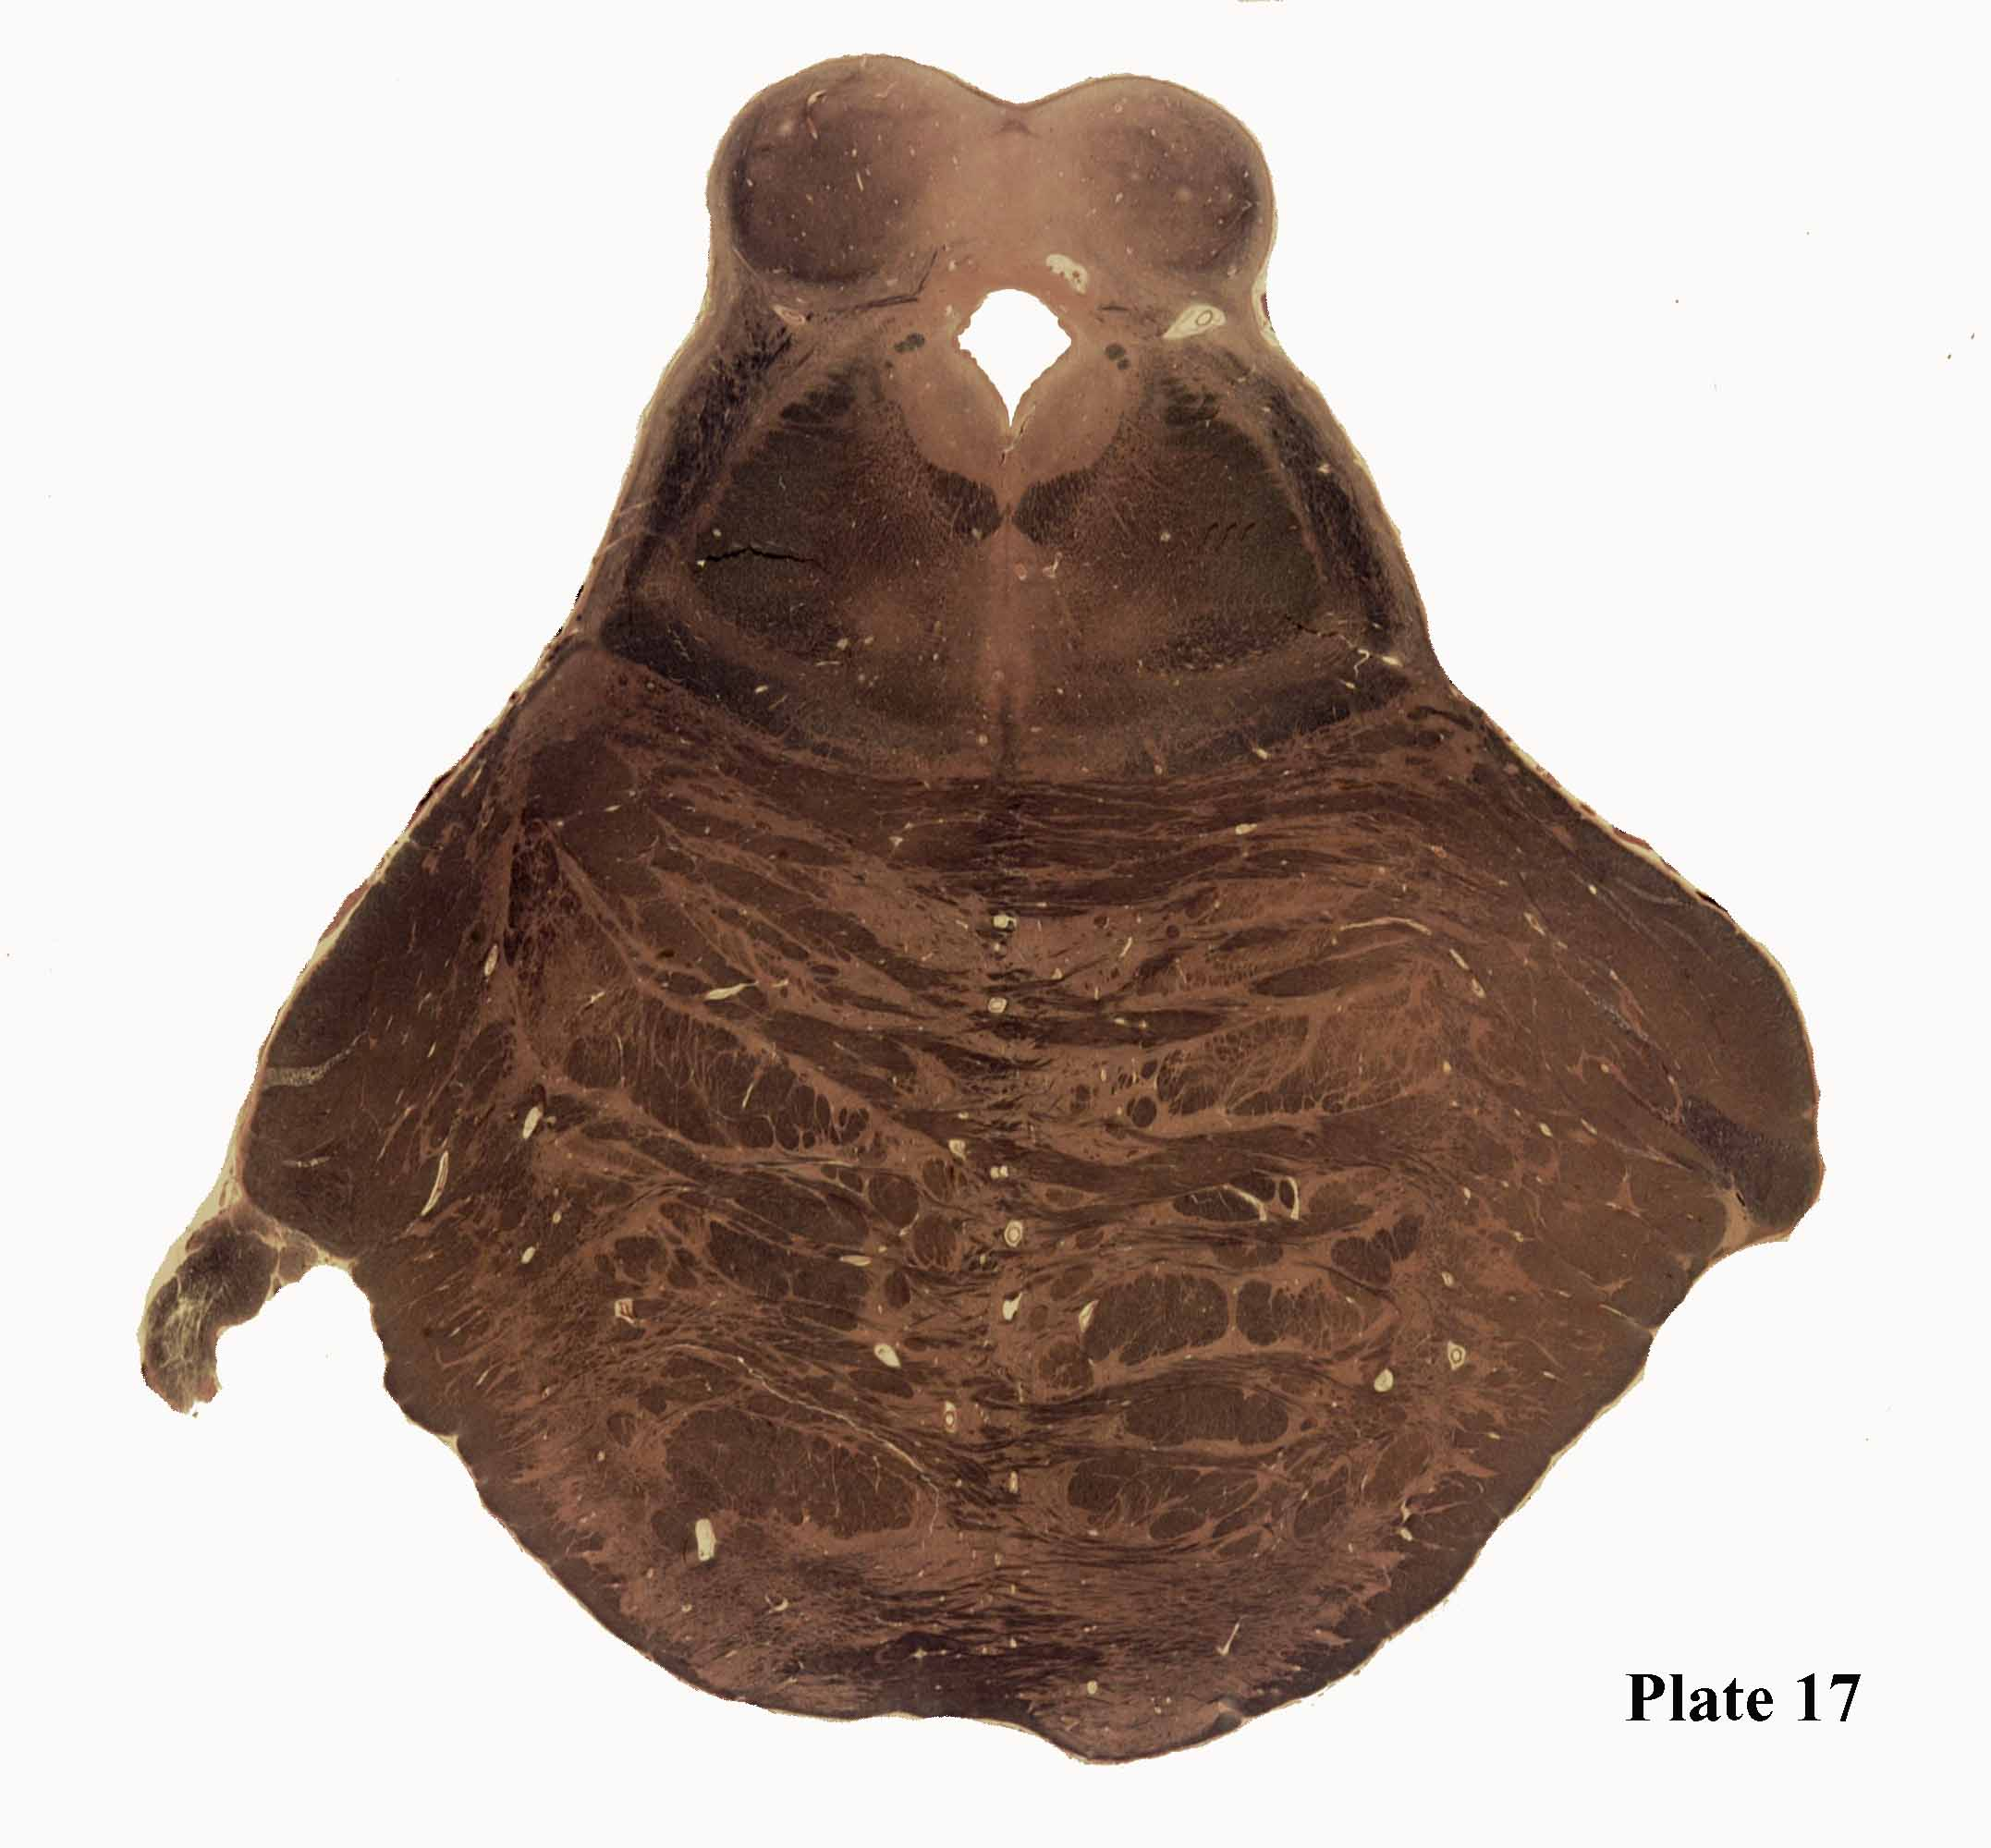
IC
CeAq
CeGy
TroNu
LL, LLNu
DLF
SCP
ALS
MLF
VTTr
CTT
ML
MidRetF
PonNu
RaNu
RuSp
MCP
CoPF
TriNr
CST

Slide 18
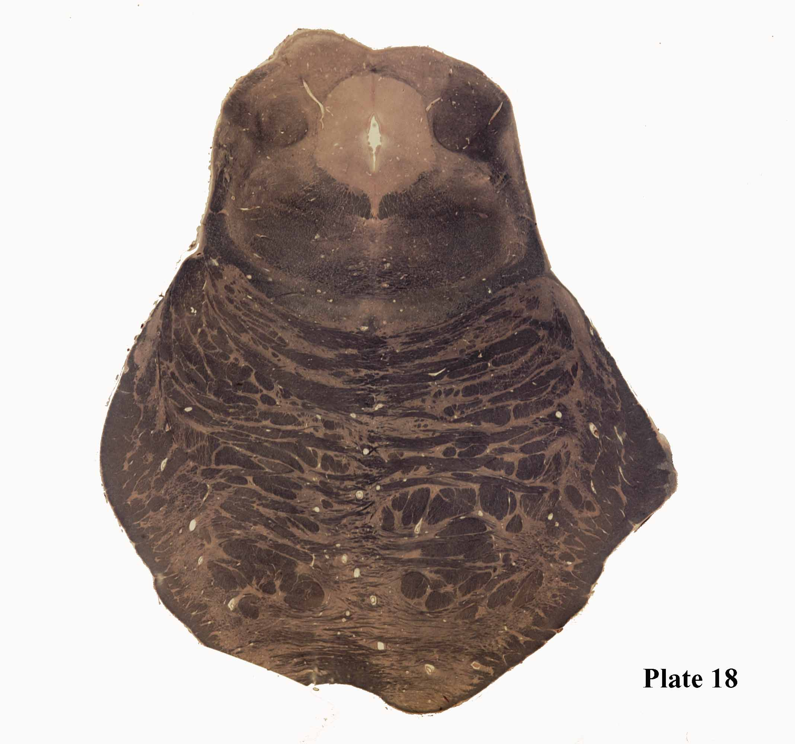
IC
SC
Cun Nu
CeGy
SagNu
DLF
LL
CTT
TroNu
ALS
MLF
VTTr
RaNu
ML
MidRetF
CoPF
decSCP
CC
CST
CoPF
RuSp
PCeF
MCP
PonNu

Slide 19
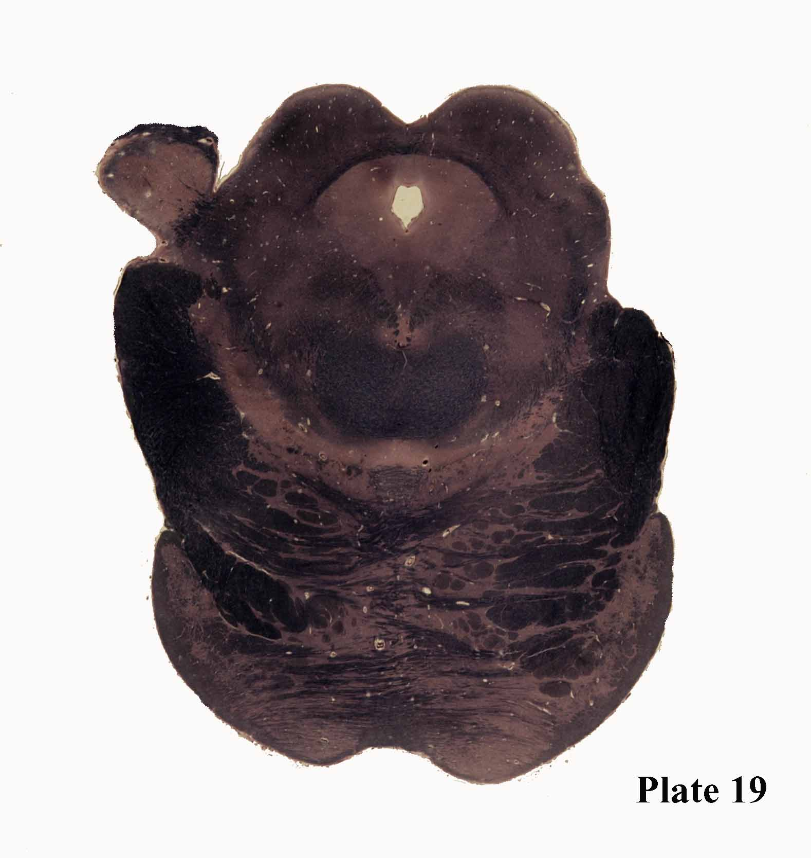
MidRetF
Central
Tegmental
tract
SC
MGB
BrIC
CeGy
VTTr
DLF
OcNu
ALS,
ML
MLF
CoPF
Substania
nigra
decSCP
CC
CST
Ventral
Temental
area
CoNF
RuSp
CoPF
Interpeduncular
nucleus
MCP
PCeF
PonNu

Slide 20
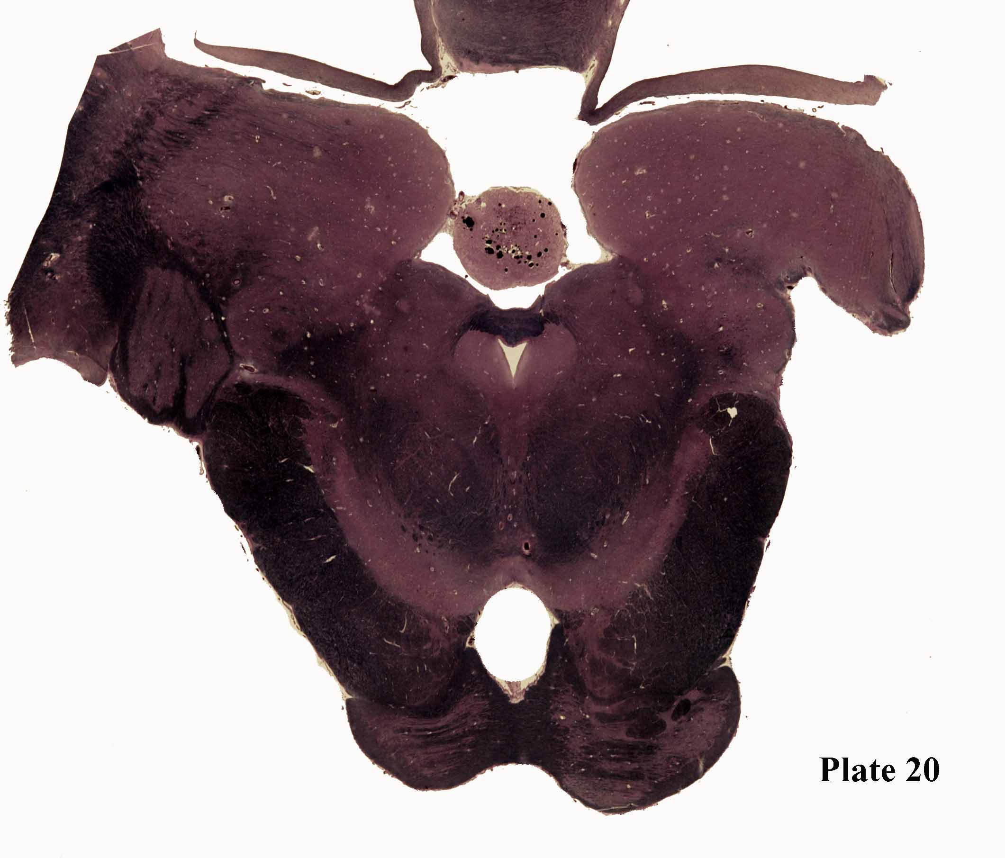
Brachium of IC
Pulvinar
Pineal
PreTec
MidRetF
Dorsal
Trigeminothalamic
tract
Posterior
commisure
MGB
Central
Temental
tract
OpRad
CeGy
LGB
DLF
OpTr
Rostral interstitial
Nucleus of MLF
ALS,
ML
CoPF
Ventral
Trigeminothalamic
tract
CST
MLF
CoNF
Cruz cerebri
Radations of
occulomotor
CoPF
Ventral tegmental
area
Substantia nigra
CTT,
CThT
RuNu
IPF

Slide 21
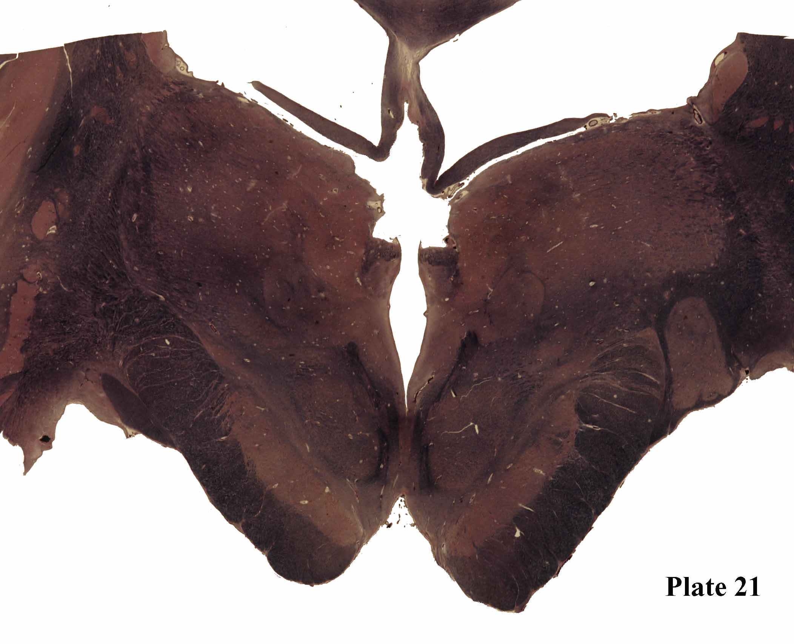
Thalamic
Reticular
nucleus
Caudate
Stria Terminalis
Ventroposterior
Lateral and medial
nuclei
Fornix
Stria medularis
Pulvinar
Centromedian
nucleus
Habenulo
pedunclular
tract
Internal
Medullary
lamina
Habenular
nucleus
Lataeral
Posterior
nucleus
Dorsomedial
nucleus
Put
LGB
OpTr
Habenulopeduncular
tract
(again)
External
medullary lamina
RuNu
CC
Internal
Capsule
(post. Limb)
ML
Ventral and dorsal
Trigeminothalamic
Tract
Subthalamic
nucleus
Cerebellothalamic tract
SN
Inerpeduncular nucleus

Slide 22
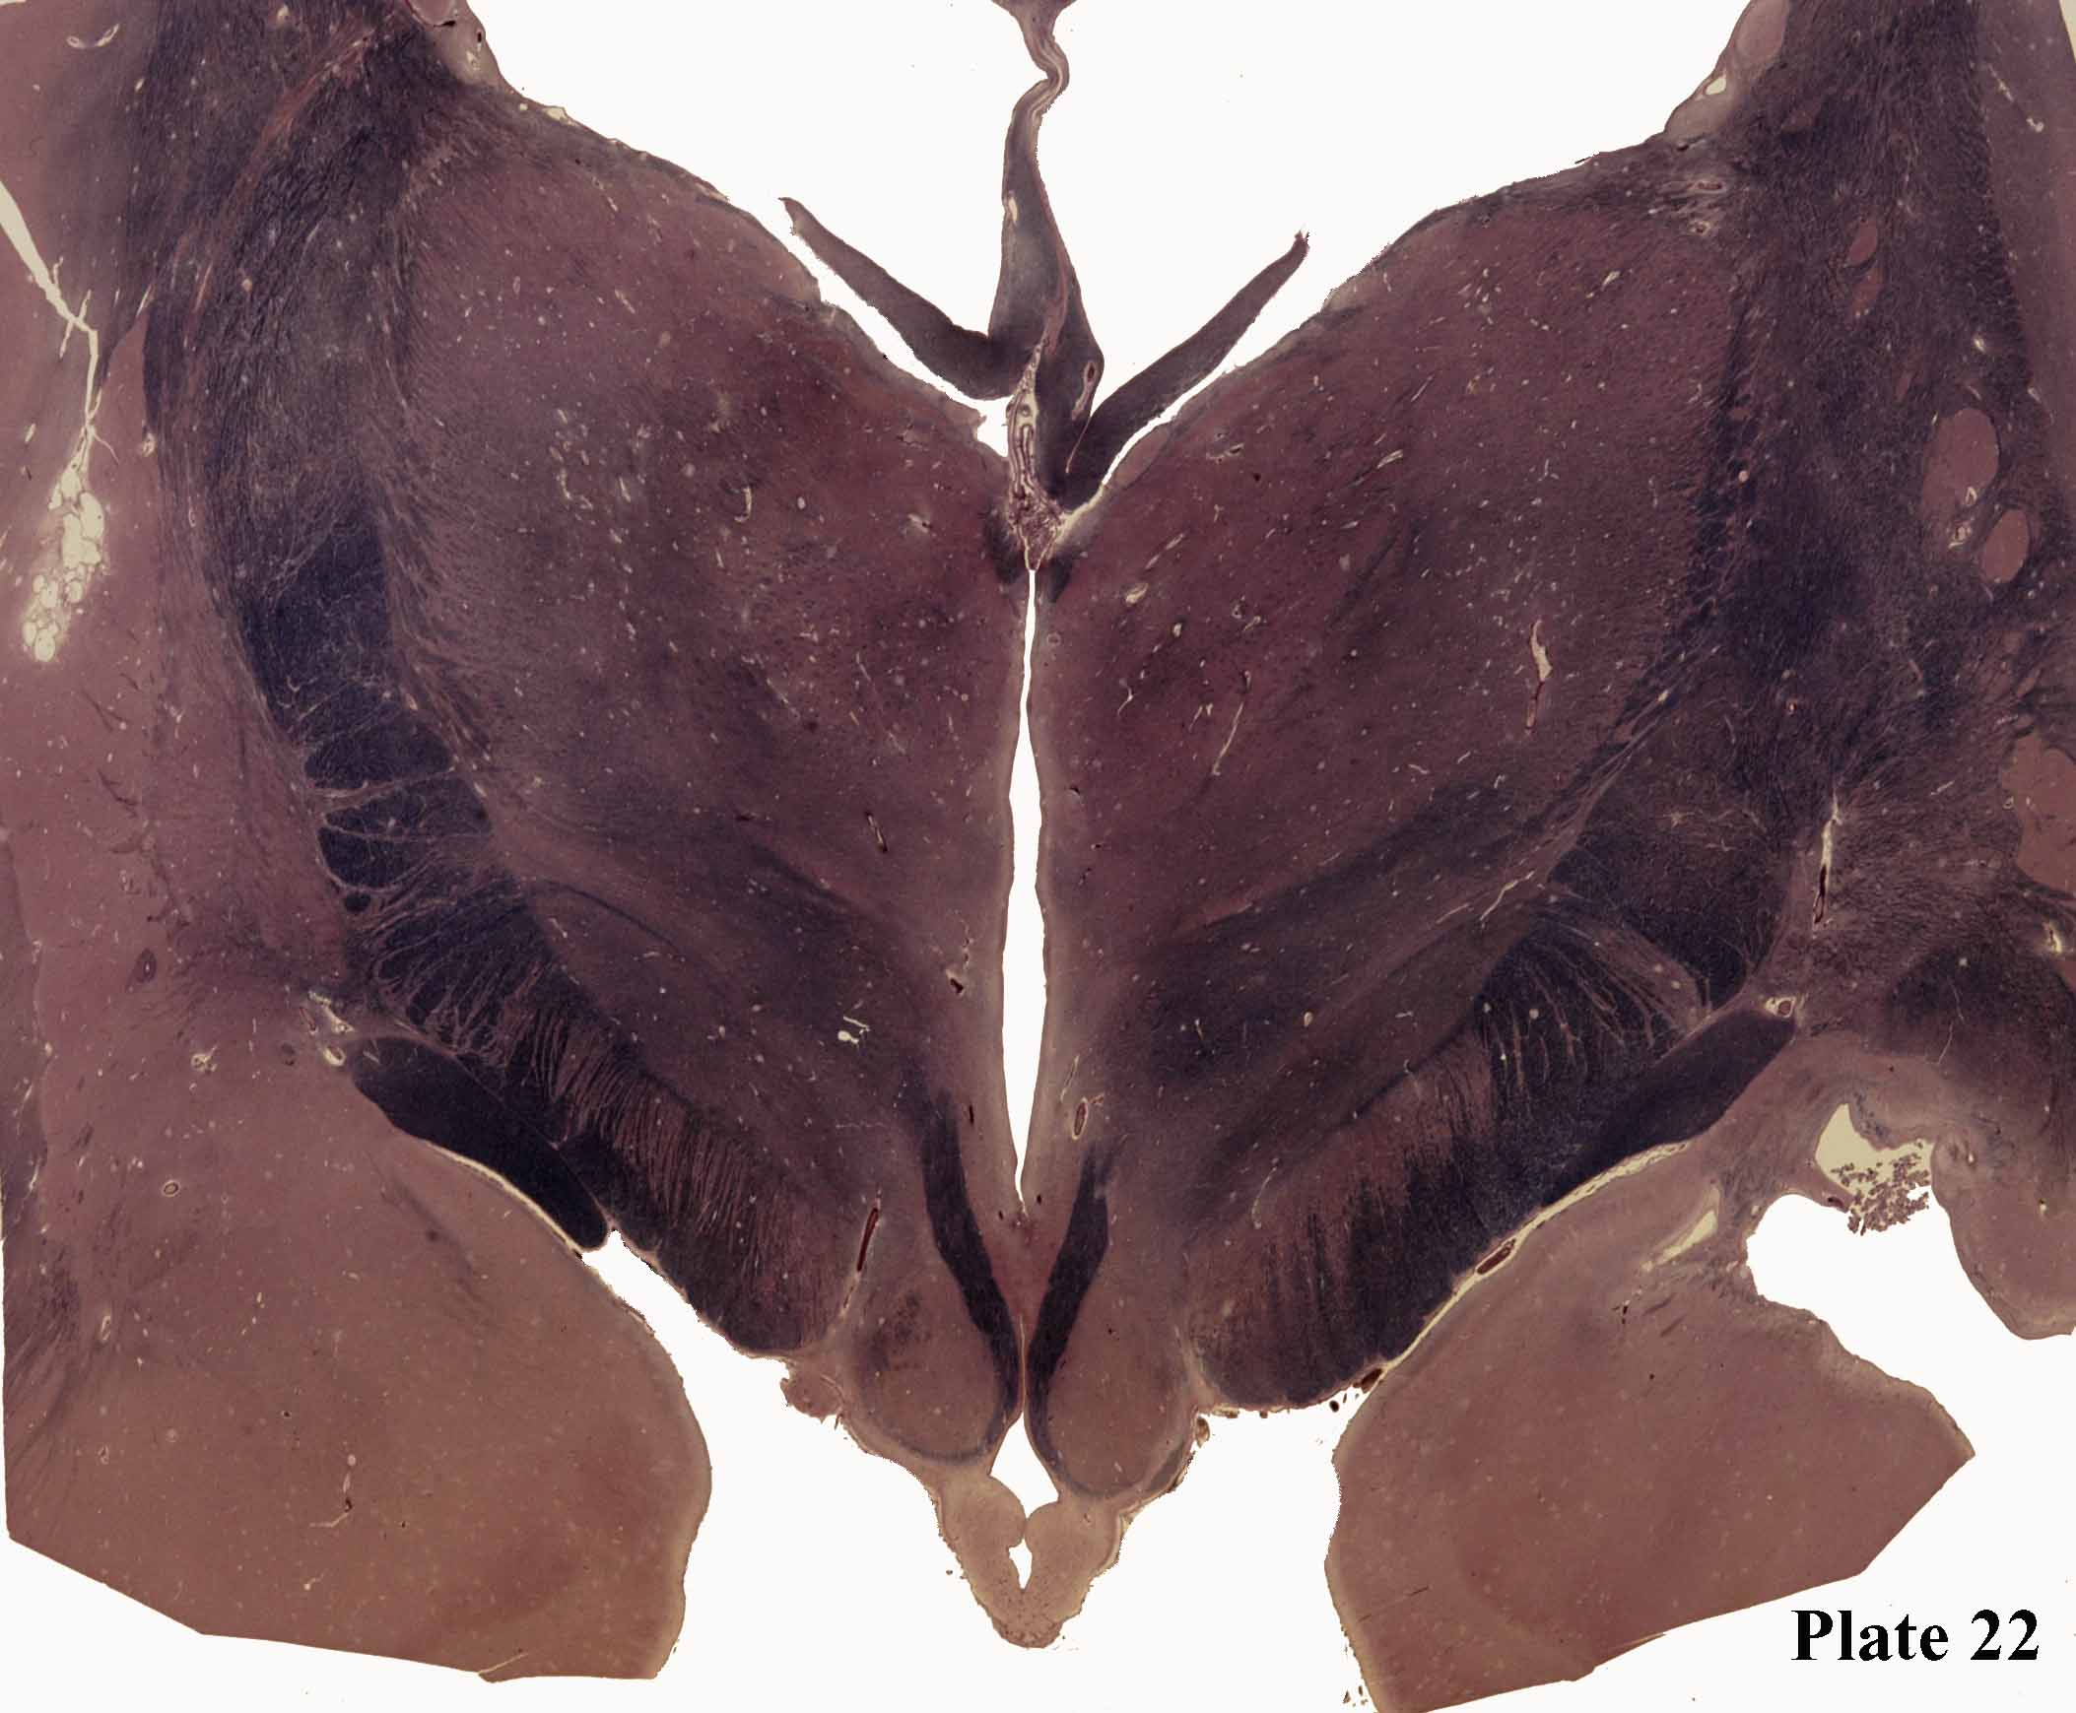
Caudate nucleus
External
Medullary
lamina
Stria terminalis
Fornix
Thalamic
Reticular nucleus
Stria medullaris
LP
IML
Put
Int Cap
Post limb
DM
VL
Globus Pallidus
(external)
Thalamic fasiculus
Globus
Pallidus
internal
Lenticular
fasiculus
OpTr
hypothalamus
Amygdaloid nuclues
CC
Mamillo
thalmic
tract
Lateral ventcle
Inferior horn
Subthalamic
nucleus
Zona
incerta
Fornix
Mamillary
bodies

Slide 23
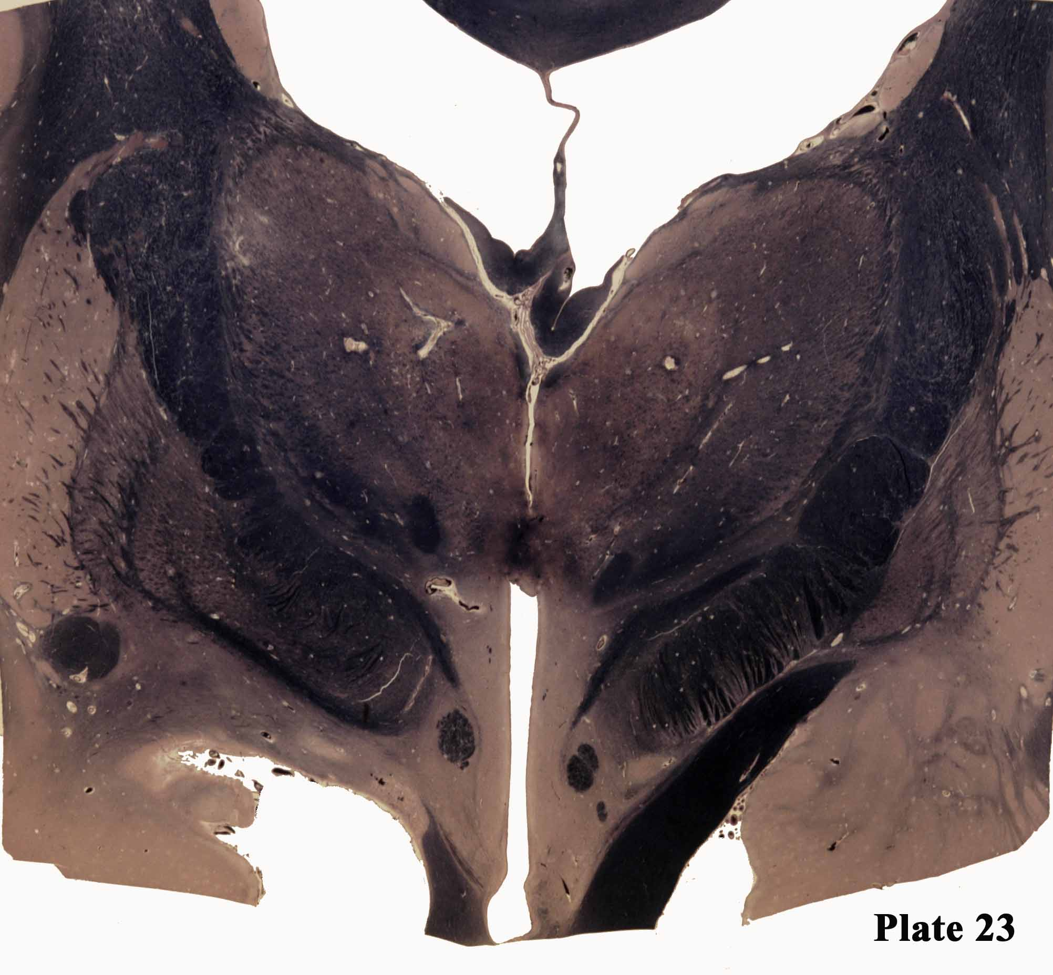
Cau
Thalamic
Retiuclar
nucleus
St Ter
Int Cap
(post. Limb)
LD
VL
Fx
Put
DM
St Med
EML
IML
GPe
Zona
incerta
ThFas
GPi
Massa intermedia
Mammillothalamic tract
CC
Anterior
commissure
Lenticular fasciculus
HyTh
Fx
Amygdaloid
nucleus
Ansa Lenticularis
OpTr

Slide 24
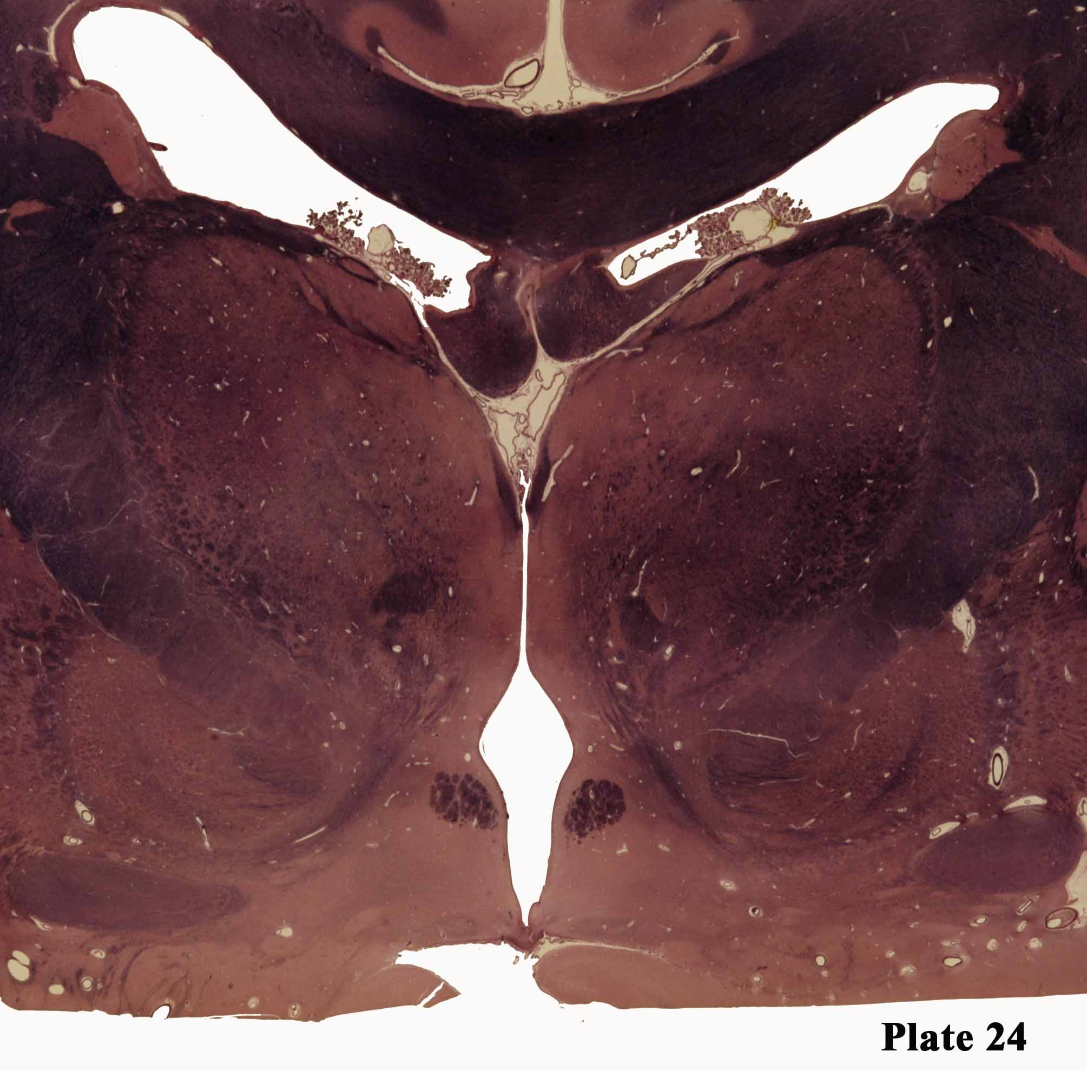
Cau
Corupus callosum
StTer
ThRetNu
LD
Fx
Internal
Medullary
lamina
VL
DM
Int Cap
StMed
Mammillothalamic
tract
Exxternal
Medullary
lamina
GPi
Ansa
lenticularis
Fx
Inferior thalamic peducnle
Anterior commissure
hypothalamus
Basal nucleus

Slide 25
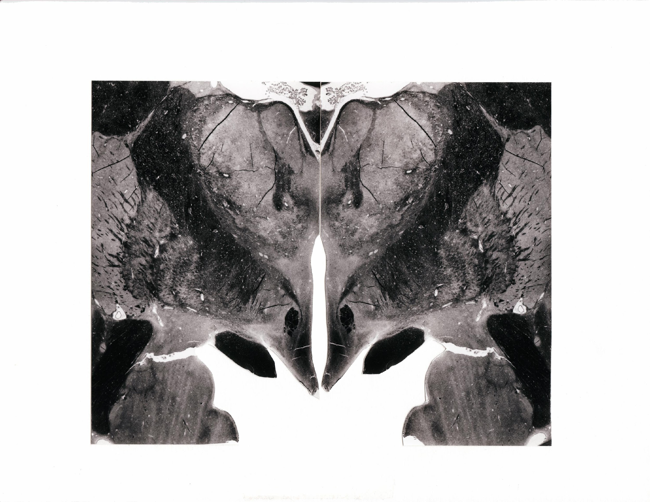
Cau
ThRetNu
AN
Fx
IML
Int Cap
VANu
StMed
Put
MTTr
EML
GPe
Lenticular
fasiculus
GPi
Fx
Ansa lenticularis
OpTr
HyTh
ACom
AmyNu
Plate 25

